Slide 1
From Models to Decision Making –
Approaches and Pitfalls
Andreas Bender, PhD
Professor for Machine Learning in Medicine, Khalifa University, Abu Dhabi, UAE
Visiting Professor, Yusuf Hamied Department of Chemistry, University of Cambridge, UK
Research Professor at UBB and Project Leader at UMF, Cluj-Napoca, Romania
Adjunct Faculty at National Institute for Bioprocessing Research and Training (NIBRT), Dublin, Ireland
Co-Founder of Healx, Ltd., PharmEnable, Ltd., and Pangea Bio Ltd.

Slide 2
Core idea of the talk
We can generate a lot of data…
We can model lots of things…
We can ‘predict everything’ (or at least build models to such end)
…
  … but do we really improve what we do?
  … so does this all matter when it comes to human-relevance (and if so, where and how precisely)?

Slide 3
Any statements made during this talk are in my capacity as an academic
Further reading:
  Artificial Intelligence in Drug Discovery – What is Realistic, What are Illusions? (Parts 1 and 2)
  Andreas Bender and Isidro Cortes-Ciriano
  Drug Discovery Today 2021
  Artificial intelligence in drug discovery – what it is, where we stand, and the path forward
  Andreas Bender et al.
  Nature Reviews Drug Discovery 2026 (in press)

Slide 4
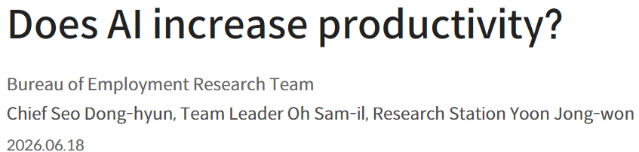
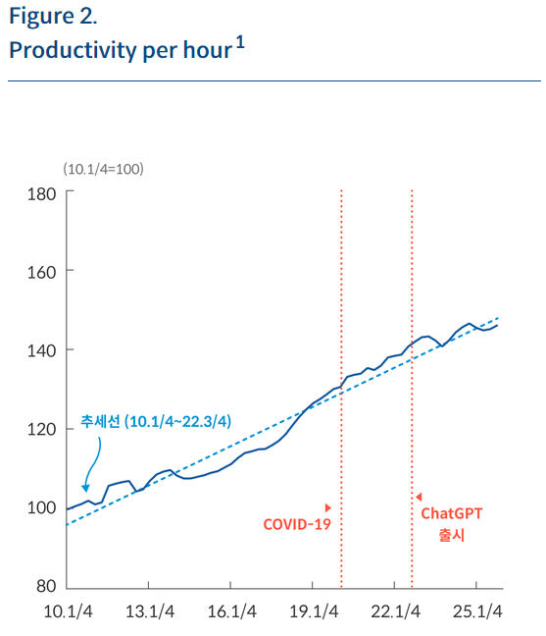
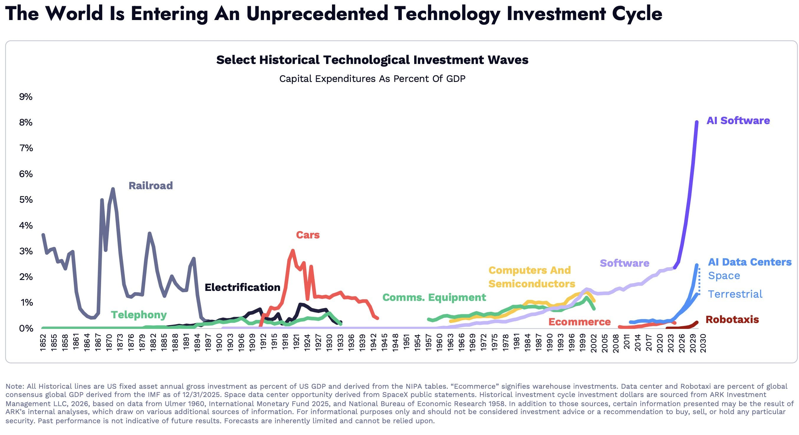
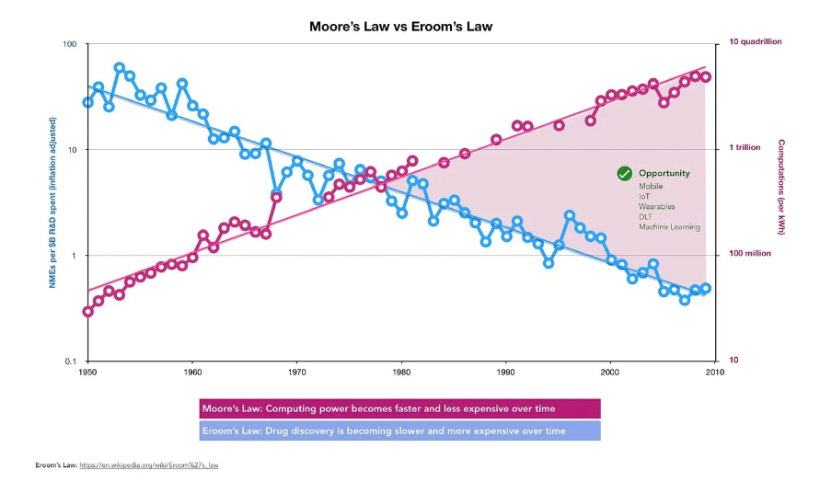
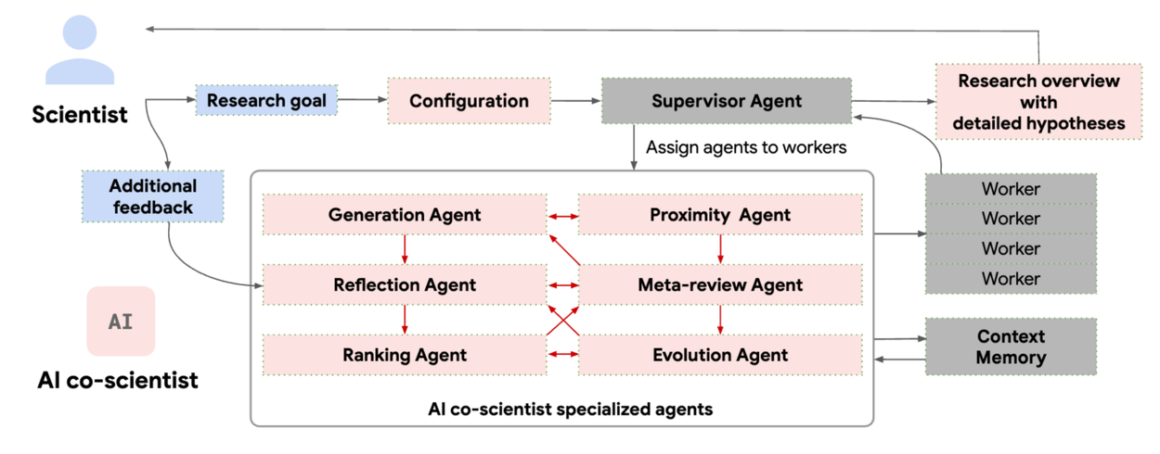
Current ‘AI Disconnect’ – e.g.
Investment in AI
Claims of Co-Scientist, ‘tech push’ (even before ‘AI’)
Marginal impact on productivity, e.g. Bank of Korea estimates ~1% impact on productivity due to AI
Eroom’s Law
in drug discovery (inverse of Moore’s Law)

Slide 5
Six Circles of Hell:
What (often) prevents AI/tech in drug discovery from having impact
6. Current Trends in Society
5. It’s Always The Incentives
4. Tech Push vs Science Pull
3. Model vs ‘Process’
2. Irrelevant metrics
1. Biological data
Clinical Goal

Slide 6
This statement is frequently encountered, often celebrated… but ultimately utterly useless
'Our model achieves 93% Performance on This and that Benchmark, which Outperforms SOTA and revolutionizes drug Discovery, for the 1001st time'
SOTA = ‘State Of The Art’, a term frequently used in machine learning that something is as good as it currently gets

Slide 7
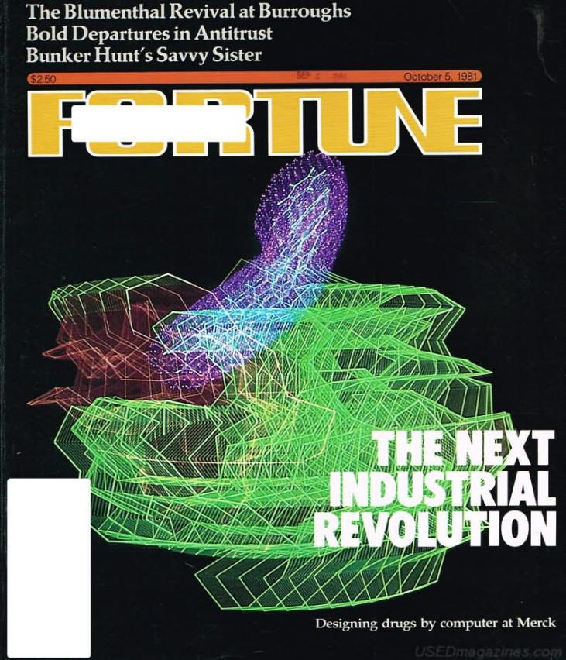
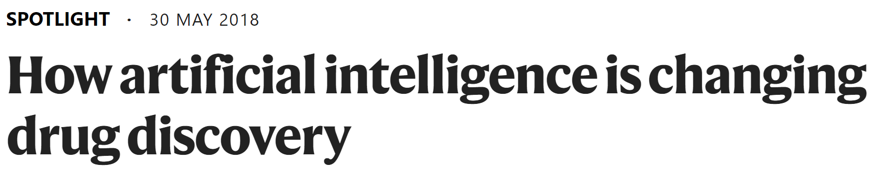
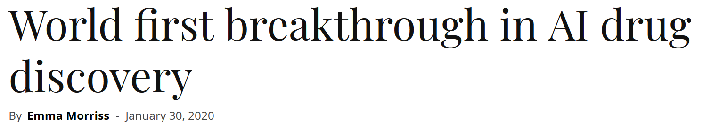
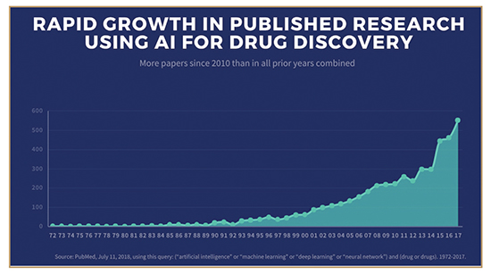
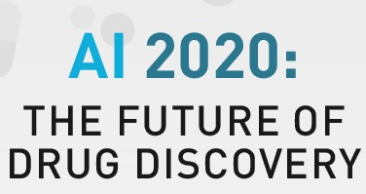
Where we are: Big headlines (like in the 80s, or 2000s…)
Fortune cover 1981
Recent headlines (2018-today)

Slide 8
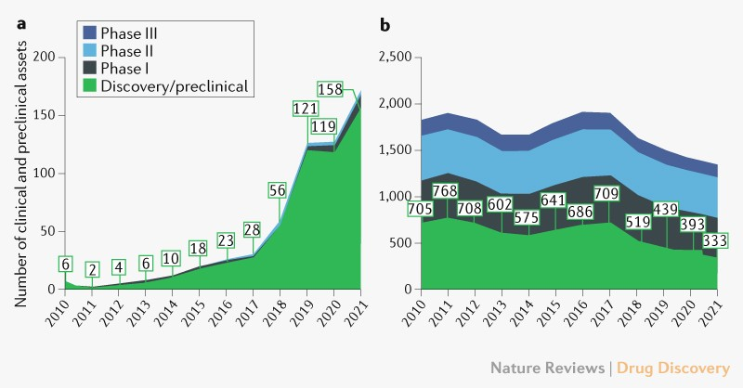
… but little translation into the clinic, and clinical success
‘AI-native companies’
Top 20 pharma
Significant number of discovery/ preclinical programs of AI companies (~160 vs ~330)
Very little Phase 1, less Phase 2, 1 in Phase 3 (2023)
-> Little in vivo safety (Phase 1) data yet; virtually no in vivo efficacy (Phase 2/3) data yet
Jayatunga et al., AI in small-molecule drug discovery: a coming wave? Nature Reviews Drug Discovery 7 Feb 2022
Most recent: 23 June 2023 Wellcome/BCG Report “Unlocking the Potential of AI in Drug Discovery”

Slide 9
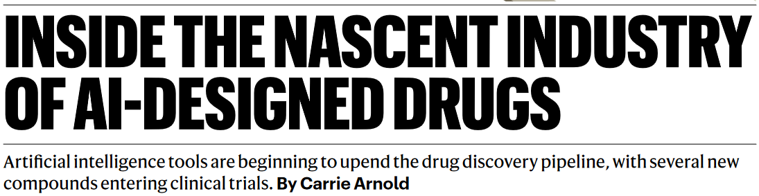
… the great awakening … yes, drug discovery is difficult!
“There’s no shortcuts to drug discovery. We can have better informed ideas, but you still have to go through the rest of the [development] process.”
“These trials are still in their early days […] he is confident that the use of AI is leaving an indelible mark on drug development and promises to make the process better, faster, and cheaper, as well as enabling the development of more first-in-class compounds.”
Arnold, Nature Medicine, 1 June 2023, “Inside the nascent industry of AI-designed drugs”

Slide 10
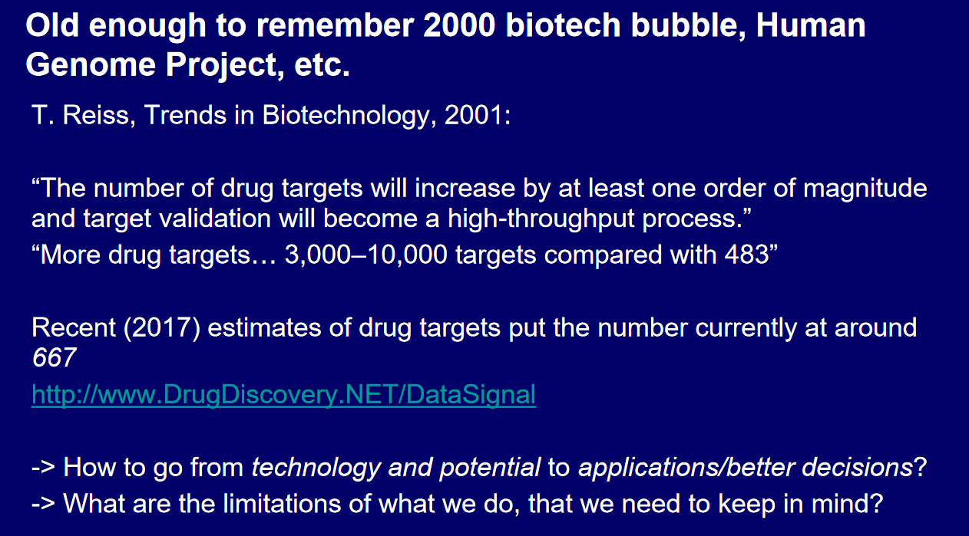

Slide 11
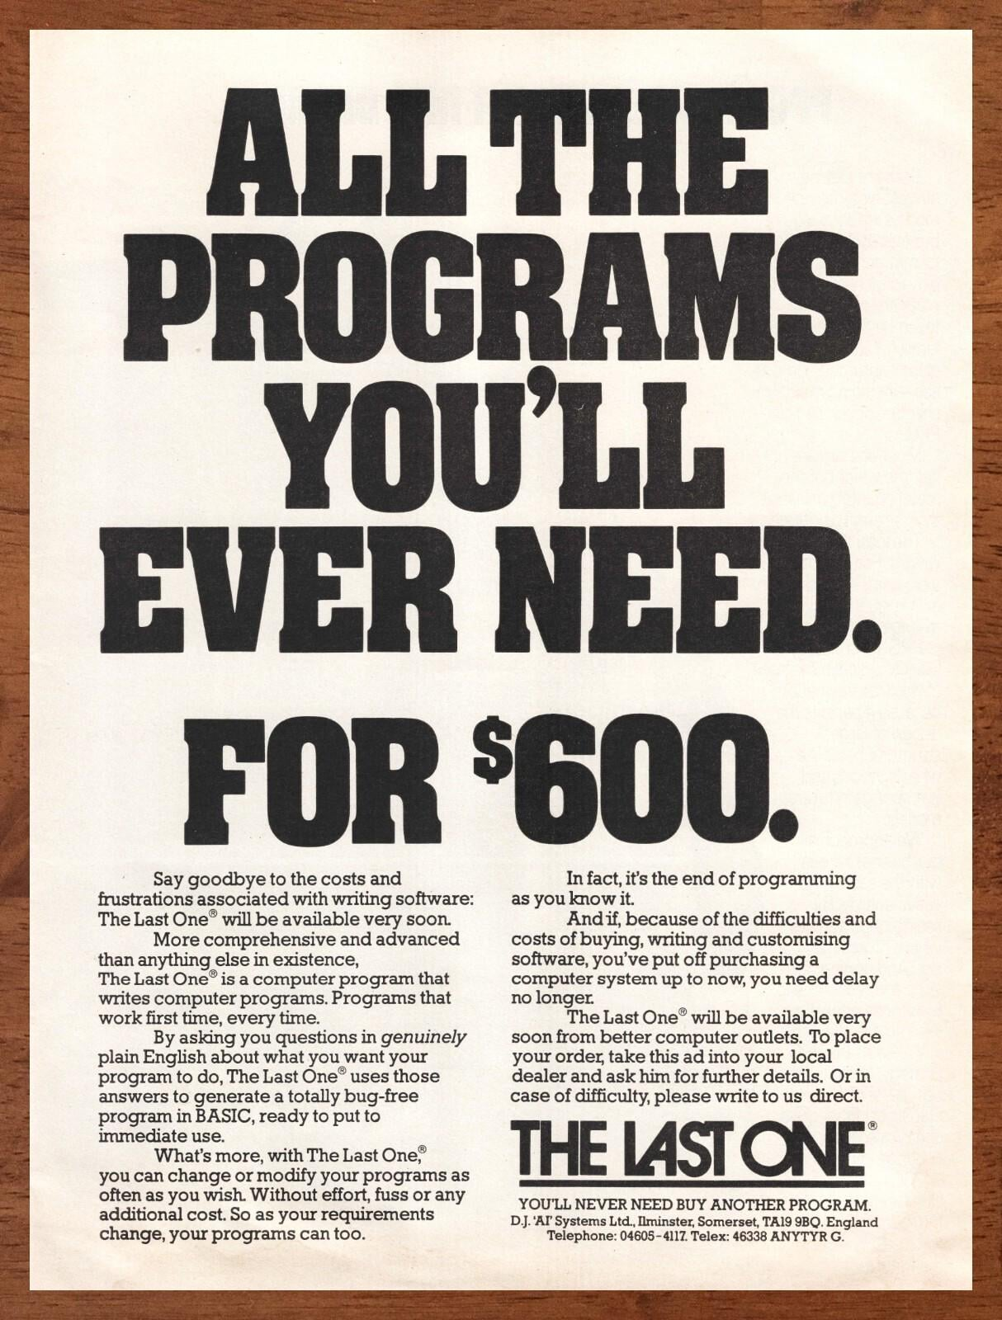
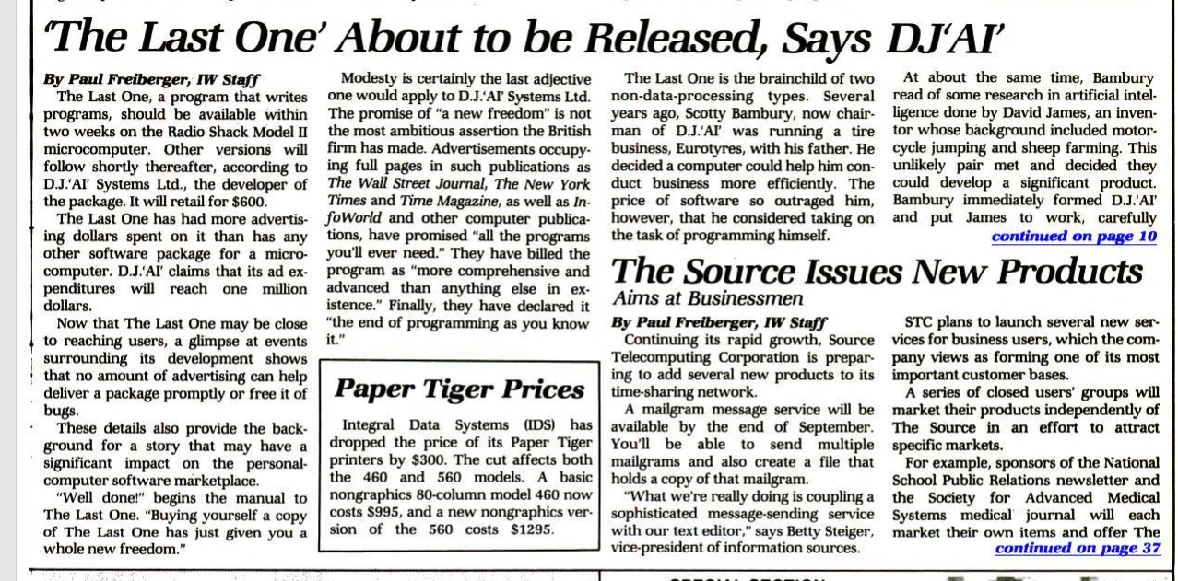
Sounds like… LLMs?
'Say goodbye to the costs and frustrations associated with writing software: The Last One will be available very soon. The Last One is a computer program that writes computer programs. Programs that work first time, every time.
By asking you questions in genuinely plain English about what you want your program to do, The Last one uses those answers to generate a totally bug-free program in BASIC, ready to put to immediate use.’
D.J. ‘AI’ Systems Ltd., 1981

Slide 12
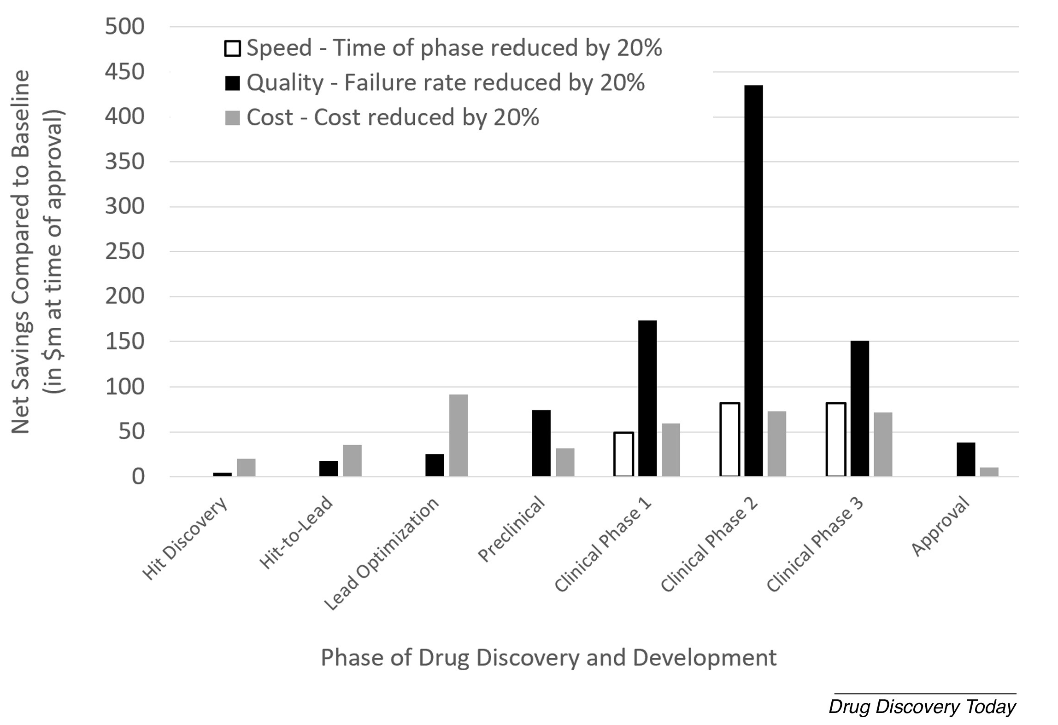
THE GOAL: Clinically relevant decisions, related to (mostly) efficacy and (also) safety
What matters is the right compound in the right patient (dosed in the right way)
Everything else matters less. Far less.
Fast is good
Cheap is good
But better is better
Bender and Cortes, Drug Discovery Today 2021
Bender et al. NRDD 2026

Slide 13
Why models sometimes don’t translate to clinical impact

Slide 14
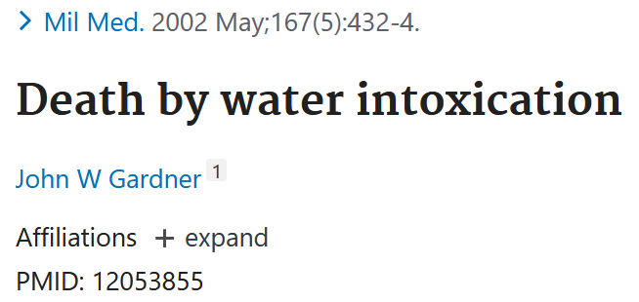
1. Biological data: a) Machine learning needs labels
b) Biological data is impossible/very hard to label
“Does drug Y cause adverse reaction Z? Yes, or no?”
Pharmacovigilance Department: Yes, if we have…
  A patient with this genotype (which is generally unknown)
  Who has this disease endotype (which is often insufficiently defined)
  Who takes dose X of drug Y (but sometimes also forgets to take it)
  Then we see adverse reaction (effect) Z …
  But only in x% of all cases and
  With different severity and
  If co-administered with a drug from class C
  More frequently in males and
  Only long-term
  (Etc.)
So – does drug Y cause adverse event Z?
Is water now toxic?

Slide 15
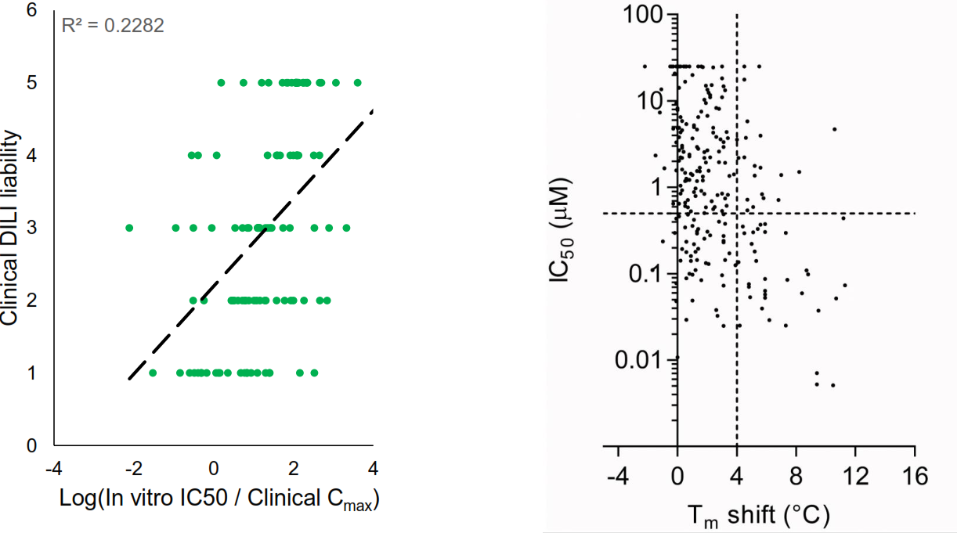
Illustration of low predictivity of much of our data, and hence labels, and hence models
Figure by Jack Scannell
Left: Clinical DILI liability related to Cmax-corrected organoid-derived IC50 values, with low correlation between both values (lower liability index values indicate higher clinical liability)
Right: Low correlation of enzymatic and thermal-shift derived activity data.
Solely feeding such data with low predictivity into ‘AI’ models will not lead to better individual decisions, and hence clinical outcomes.
Proctor WR et al.. Utility of spherical human liver microtissues for prediction of clinical drug-induced liver injury. Arch Toxicol. 2017 Aug;91(8):2849-2863.
Rudolf AF et al.. A comparison of protein kinases inhibitor screening methods using both enzymatic activity and binding affinity determination. PLoS One. 2014 Jun 10;9(6):e98800.

Slide 16
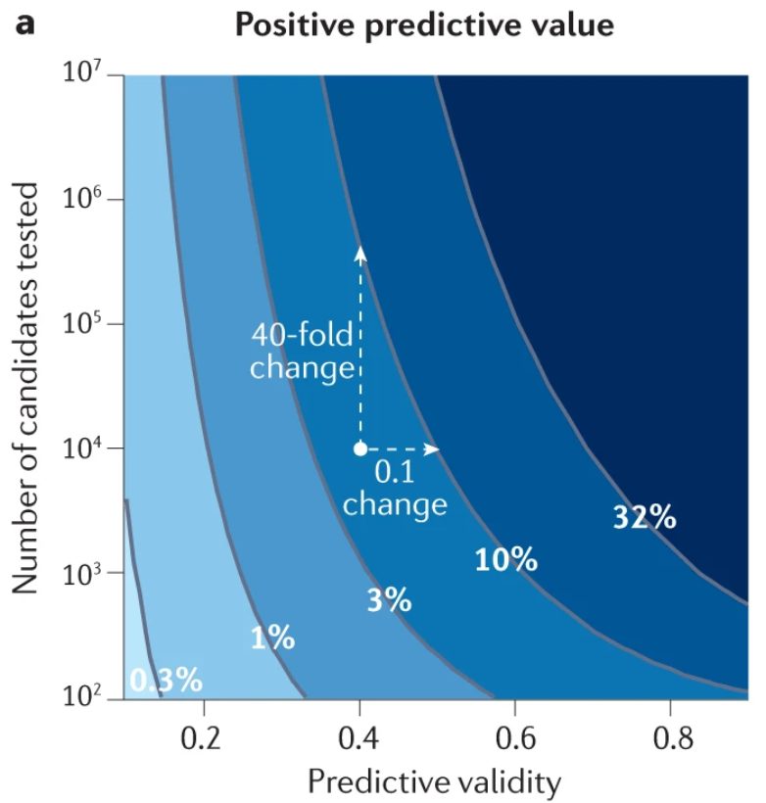
A 10% better predictive validity is worth ca 10-40x the number of compounds tested (!)
“[...] an absolute 0.1 change in predictive validity (horizontal axis) has a bigger effect on PPV than a 10× change in the number of candidates tested (log₁₀ scale on the vertical axis). For example, increasing predictive validity from 0.4 to 0.5 with 10⁴ candidates tested raises PPV from 5% to 10%; about the same effect as increasing the number of candidates tested by a factor of 40 while holding predictive validity constant at 0.4”
Scannell et al. Predictive validity in drug discovery: what it is, why it matters and how to improve it. Nature Reviews Drug Discovery 2022

Slide 17
Is bigger, is more better (in terms of data)?
How much data do I want? MBs? GBs? TBs? PBs?
I want precisely 1 bit of data (per decision that needs to be made)
But the right bit – the one that tells me, ‘yes or no’ (is this the right molecule, for the given purpose, etc)

Slide 18
Bottom line
'Our model achieves 93% Performance on This and that Benchmark, which Outperforms SOTA and revolutionizes drug Discovery, for the 1001st time'
… does not really matter (by itself) – given the labels we use are proxy labels, and/or conditional

Slide 19
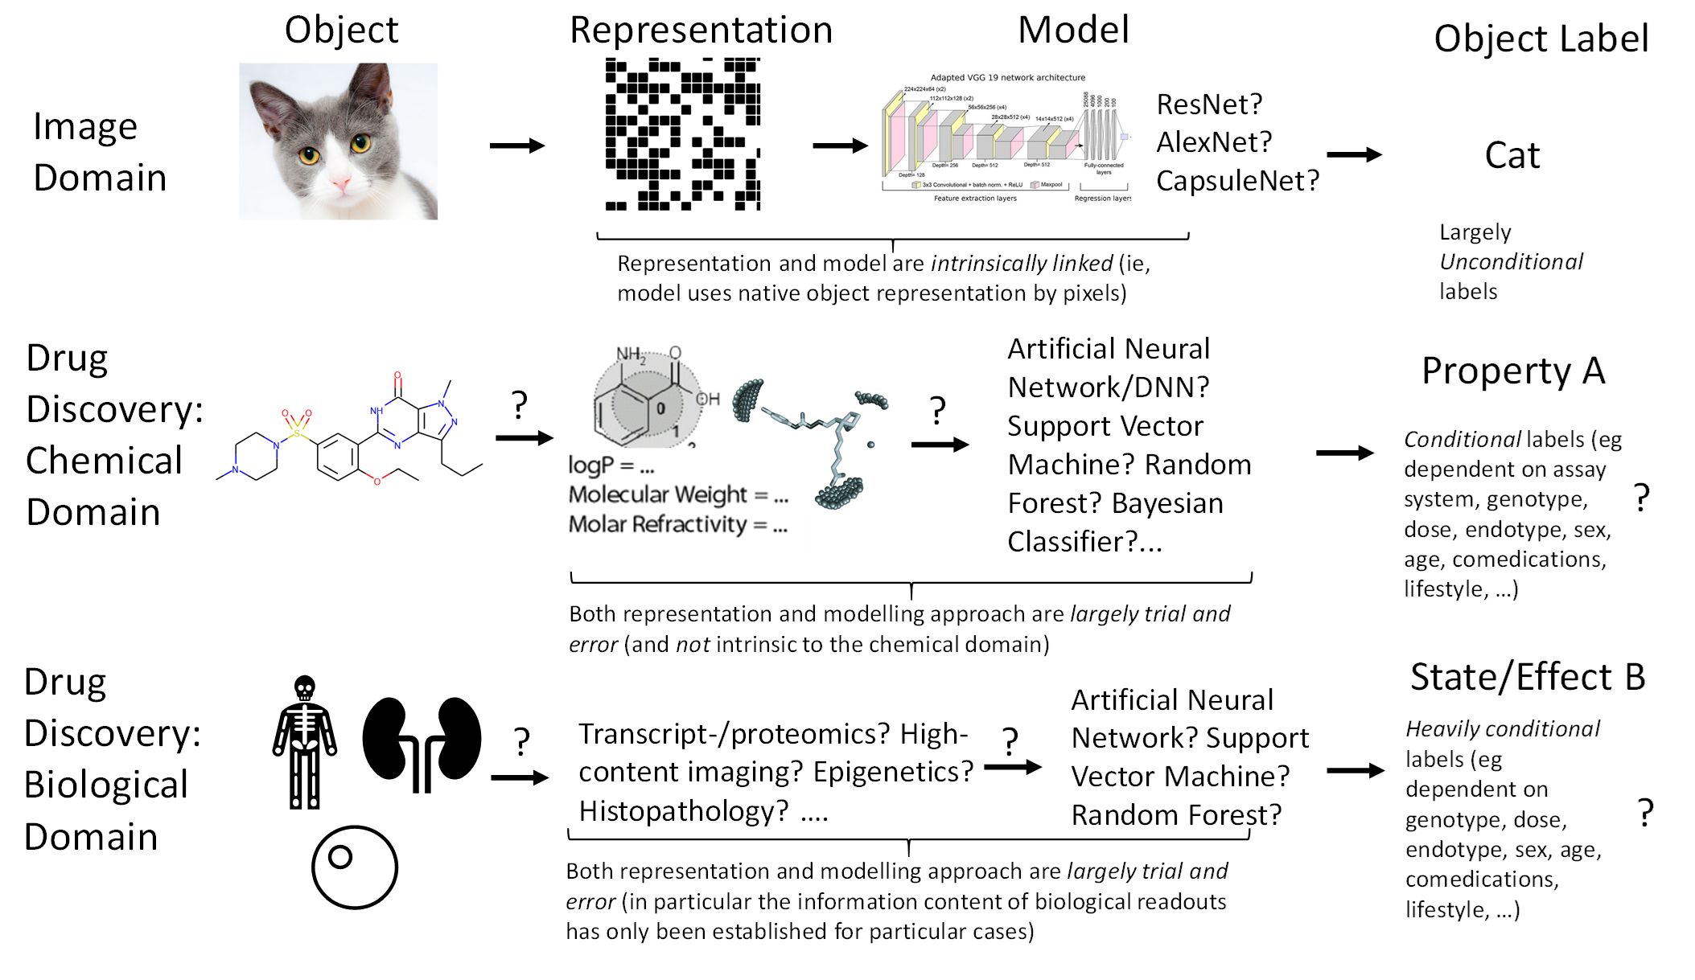
Integration of object, its representation to the ML model, modelling approach, and unconditional labels as target annotations -> good for machine learning
Worse integration of object, representation to the ML model, modelling approach, and conditional labels as target annotations -> bad for machine learning
Worse integration of object, representation to the ML model, modelling approach, and conditional labels as target annotations -> bad for machine learning
Bender & Cortes
Drug Discovery Today 2021

Slide 20
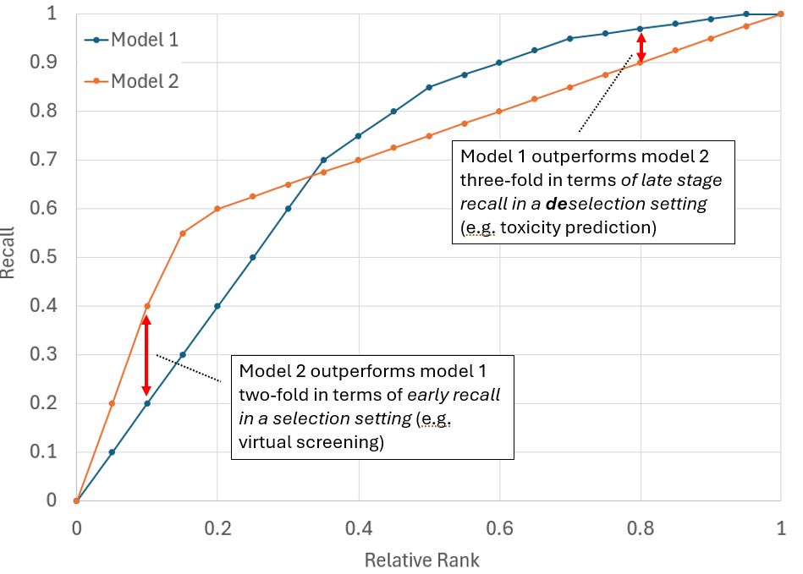
2. Irrelevant metrics: Generic model metrics never matter
AUC of both models is identical – behaviour vastly different
In an early recall setting (‘virtual screening’) model 2 is 2-fold better than model 1
In a late-stage deselection setting model 1 is 3-fold better than model 2
Performance measured without use-case (often AUC, overall accuracy etc) is generic, and never matters in a use case
The ‘use case’ extends far beyond performance metric: Which library is used, which target, etc etc.

Slide 21
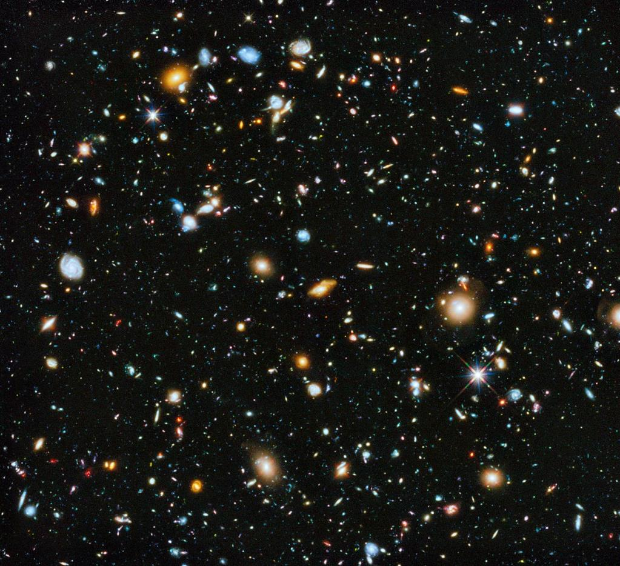
2.2. A numerical performance on one dataset does not necessarily (and hardly ever!) predict performance on another dataset (=project)
Chemical space is large; data sets are small
Retrospective validation, training/test splits… give you performance numbers
Future projects will by definition be outside the training set distribution
Also time-split doesn’t help, it’s just different galaxies
Performance measured retrospectively will not hold prospectively (in future projects)
Next Project?
‘External Test Set’
‘Training Set’
‘Validation Set’

Slide 22
Many of our models (and companies) are more based on ‘belief’ (and proxy values) than numbers
We cannot really validate our models and approaches, since this operates mostly in proxy (non-clinical) space, and in a retrospective manner (not on future project space)
We cannot (hardly) measure progress in biotech, which is different from ‘tech tech’:
Tech has ARR, user growth, click rates, precision/recall (on labels meaningful in the given context)
Bio-ML has … nothing/not much (in terms of relevant metrics for final endpoint, efficacy/safety in the clinic)

Slide 23
Also applicable to current models – e.g. virtual cell validation metrics
On average often use-case irrelevant
Point-error based metrics (RMSE etc): The sound pretty good… if on average there is no change anyway, and that’s what you just always predict (but it’s not what you are interested in!)
Correlation-based metrics (R2 etc): Often sound good … but in decision-making situations you are hardly ever interested in overall distributions (you need within-group differentiation, etc)
…
Applies also to many other models of course (non-goal directed metrics in early generative chemical models, etc)
Validation needs to be use-case relevant (see next section)
‘Out of 10 compounds we prospectively tested, what is the precision?’

Slide 24
Bottom line
'Our model achieves 93% Performance on This and that Benchmark, which Outperforms SOTA and revolutionizes drug Discovery, for the 1001st time'
… does not really matter – because metrics used for model validation are hardly ever use-case related

Slide 25
3. Model validation does not matter – it’s about the ‘process’ (… which only gets validated in the clinic!)
“Don’t mistake the map for the territory”
Models never capture the real-world use case – every model is underspecified
Biology is not label prediction
Relevant decisions need to be in vivo-relevant; for in vivo-relevant decisions we don’t (hardly) have a ground truth
D’Amour, A. et al. Underspecification Presents Challenges for Credibility in Modern Machine Learning. J. Mach. Learn. Res. 23, 1-61 (2022).

Slide 26
The current focus on ‘model performance’ is insufficient for real-world improvements
Compound with project context
(Disease, endotype, target, target organ, anticipated dose in man,…)
Follow-up assays, etc.
Decision in disease context (in vivo relevant!)
Input
Data
Prediction,
Confidence
Model
Improving model performance
Bottom line: Model metrics by themselves are insufficient for ‘process’ impact
‘Improving drug discovery’

Slide 27
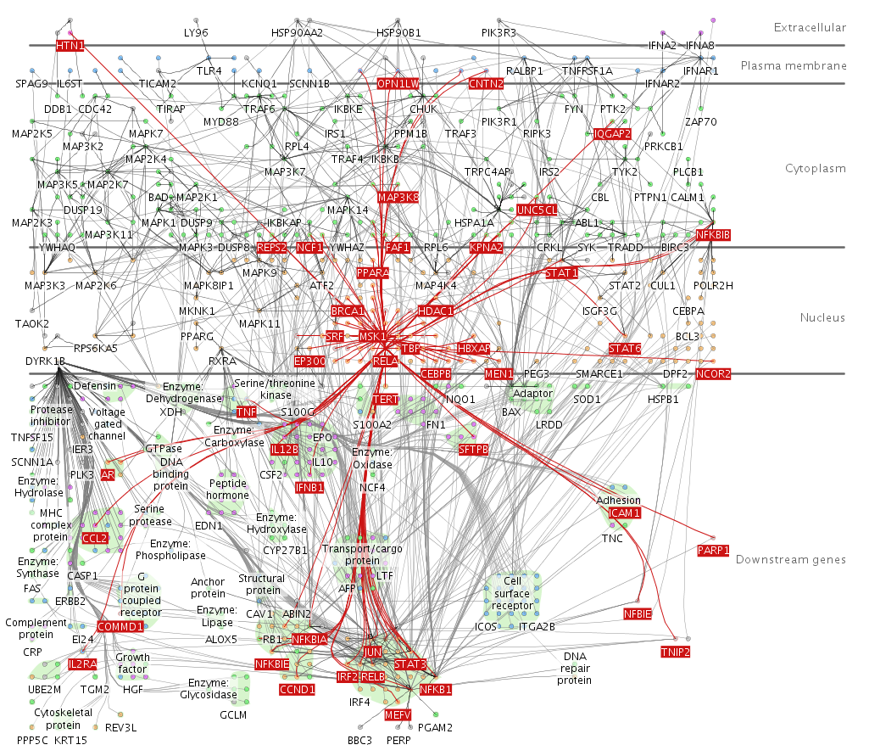
Difference between ‘publications’ and ‘reality’
Goal achieved in a publication:
Situation in real-life:
“Give me precisely one compound/target to proceed with
You have one million options, and exactly one chance
If your choice is wrong, the company you have built painstakingly over many years goes bust
Based on the figure on the left, what is your answer?“

Slide 28
Why ‘AI’ will never do drug discovery (by itself), from Virtual Cells to LLMs: Prioritization in high-dim spaces
Typical use case:
High-dimensional data spaces (input, sometimes also output)
Noisy data/high uncertainty; low predictive value
Requirement to prioritize to small numbers (experiment, 10²-10⁵) from large spaces (say, 10⁶⁰, real world say 10¹²)
Noisy data/high uncertainty/low predictivity will often not allow us to arrive at sufficiently high precision for many real-world use cases (whether Knowledge Graphs, Virtual Cells, LLMs, …)
Even low relative false positive rates will translate into large absolute numbers of false positives
We need to work on the predictive value of what we do

Slide 29
Bottom line
'Our model achieves 93% Performance on This and that Benchmark, which Outperforms SOTA and revolutionizes drug Discovery, for the 1001st time'
… does not really matter – because it is a model metric, not a ‘process’ metric (… to the extend drug discovery actually is a ‘process’)

Slide 30
4. The Tech Hammer Looking for the Use Case Nail
‘Tech push’ inverts logic of purpose/data/method/use:
Koichi Handa et al., DDT 2025

Slide 31
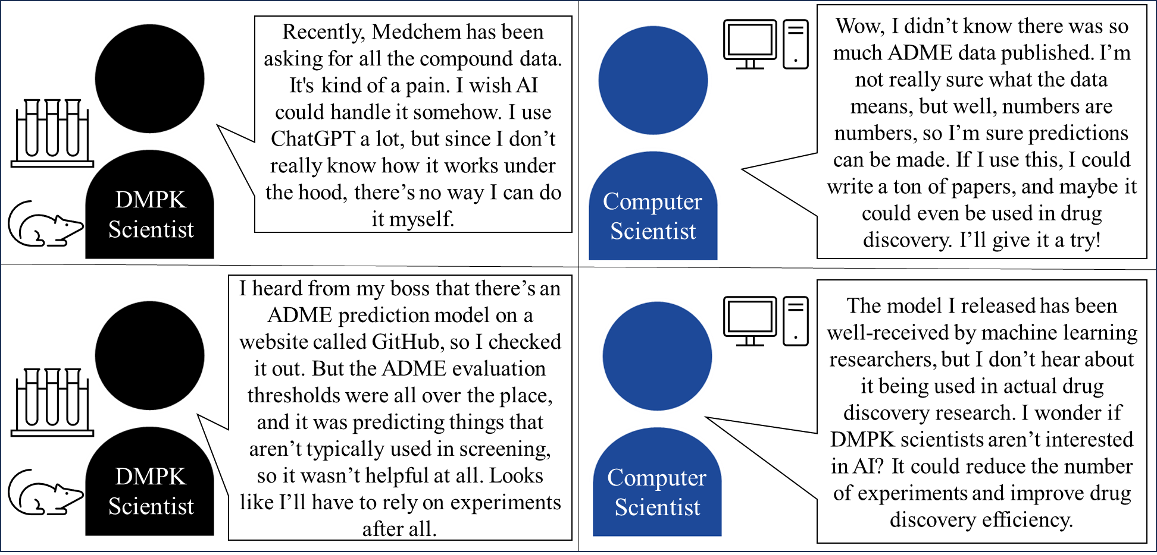
Illustration of experimental/AI disconnect
Koichi Handa, Teijin Pharma (DDT 2025)

Slide 32
5. ‘Our model outperforms…’ It’s Always the Incentives A (huge) problem in a space without meaningful metrics
Absence of fast feedback on long-term reward function (clinical success), hence optimization on proxies, e.g.:
Big Pharma -> ‘we need a winner’ (we generated TB of data, we now work with DeepLearningAgenticSuper.AI, …)
Academia -> ‘we published another high-impact paper and improved SOTA, yet again’ (on entirely irrelevant benchmarks)
Start-Up Companies -> Stuck in the pain of ‘platform validation’ and pilots
Grant funding agencies
Publications
Vicious circle of ‘we fund excellent research’ (overhyped science of the day, published in ‘high-impact journals’) and ‘we publish what gets cited’ (overhyped science of the day, people who have done it before)

Slide 33

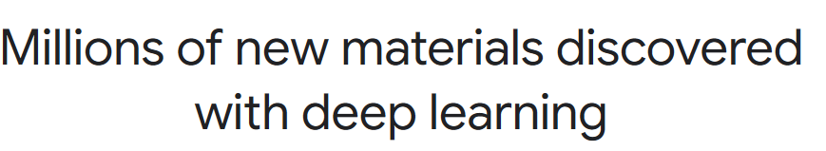
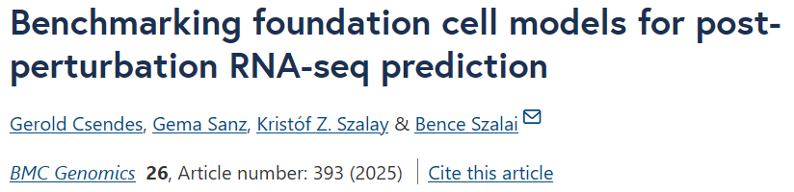
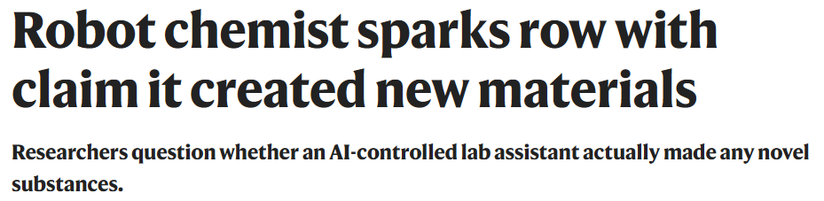
The result of wrong incentives: Lots of hyped Pseudoinnovation
“In this study, we benchmarked two recently published foundation models, scGPT and scFoundation, against baseline models. Surprisingly, we found that even the simplest baseline model—taking the mean of training examples—outperformed scGPT and scFoundation.”
“I don’t think the entire work is garbage,” says Schoop. “But the analysis of the products clearly failed. Completely.”
Problems to evaluate what really works
‘The bullshit asymmetry principle’; it takes 10 times more energy to refute bad science than to create it
Note: Prospectively validated exceptions do exist!

Slide 34
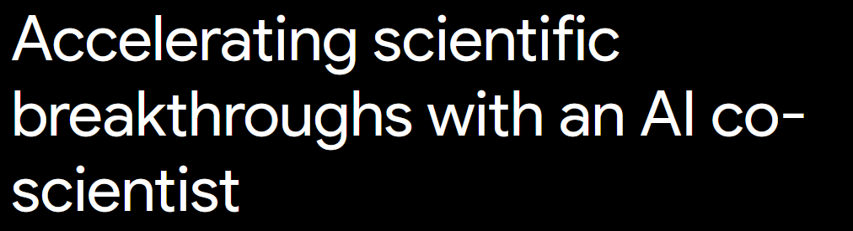
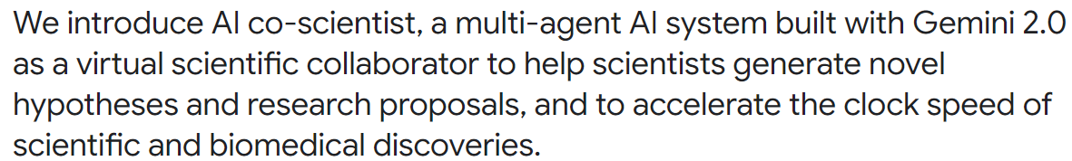
Problems with relevant validation of ‘Co-Scientist’ approaches (generally, not only Google)
Google Research, 19 Feb 2025
https://www.drugdiscovery.net/2025/02/20/the-google-co-scientist-hasnt-yet-lead-to-breakthroughs-a-closer-look-at-its-scientific-validation/

Slide 35
Validations performed and why it’s shaky ground
‘Drug repurposing for acute myeloid leukaemia’
  Biminetinib found to have 7nM IC50 in AML cell lines
  … but putting a known kinase inhibitor into a cell line is no ‘repurposing’
‘Advancing target discovery for liver fibrosis’
  Only ‘drug effects on fibroblast activity’ are shown, this does not ‘validate a new target’
‘Explaining mechanisms of antimicrobial resistance’
  Algorithm re-discovers parallel experimental results
  Yep, we all know how that works!

Slide 36

6. The really big picture: Trends in Society
Transition of authority from ‘experts’ and facts; to ‘influencers’ and public opinion/’belief’
Hence, focus is not on right and wrong, just opinions
Add ‘money push’ (check LinkedIn these days…) ‘AI can do everything and will change the world’ vs the everyday pain of ‘my data isn’t clean and my model doesn’t extrapolate’
Leads to adoption of immature technology (Klarna, Duolingo, …)
Pressure on pharma to ‘innovate’; in absence of relevant validation this can lead to ‘pseudoinnovation’
Gets exploited by tech-first companies (‘we know how to do this!’… well, usually, no!)

Slide 37
Problem because outer circles push inside
6. Current Trends in Society
5. It’s Always The Incentives
4. Tech Push vs Science Pull
3. Model vs ‘Process’
Public perception forms (e.g. via shareholders, reporting lines) which models, data, processes are used inside a company
2. Irrelevant metrics
1. Biological data
Clinical Goal

Slide 38
Is there a space outside those circles? Yes:
Generally where use case, data, methods, and tool/process are aligned:
  Ligand discovery (virtual screening) / ligand-target prioritization
  PK-based compound deselection
  Transcriptomics-based cellular reprogramming
  4. … where is this space for imaging readouts?

Slide 39
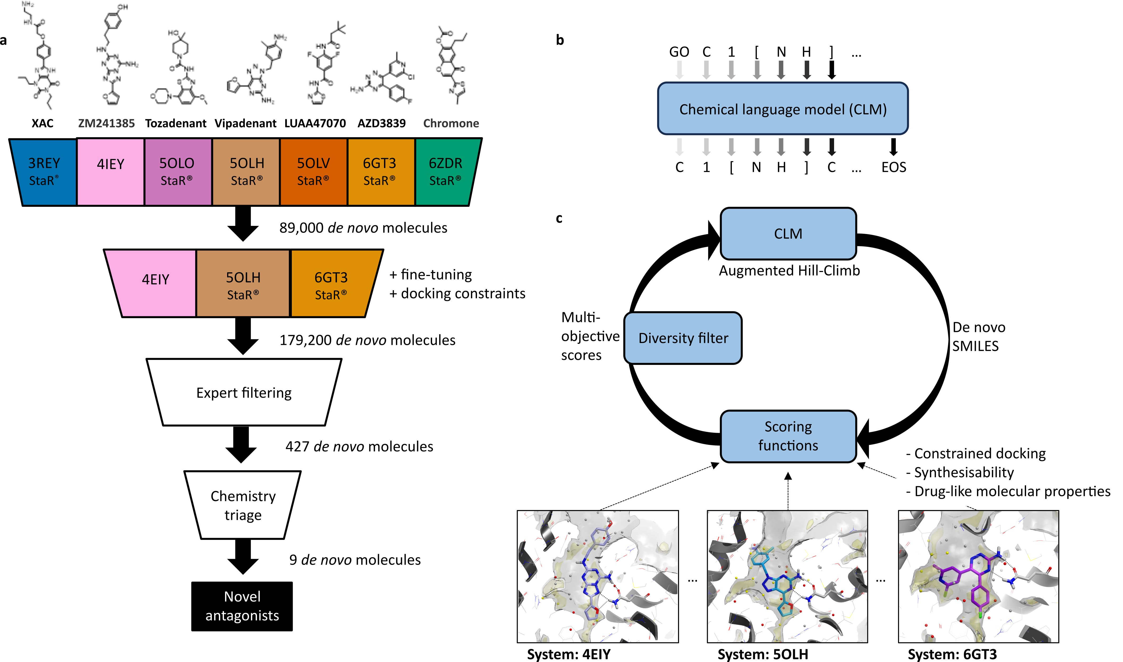
1. Binder Design (both small mols and biologics)
Ligand-based models, structure-based models: Docking, Molecular Dynamics (MD), Free Energy Perturbation (FEP), Co-folding, etc…
Binding is a physics-based process
We can model it ‘reasonably’ well (except e.g. water entropy)
Problem: Translation to functional efficacy
Why does it ‘work’? Reasonable ‘ground truth’ (binding energy), sufficient number of data points, fast reward loops for verification

Slide 40
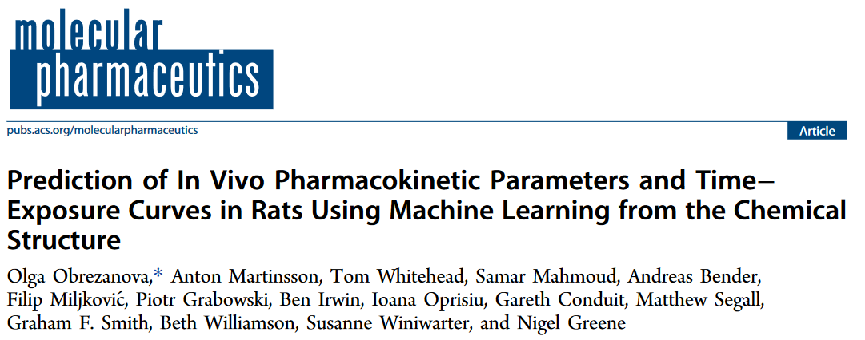
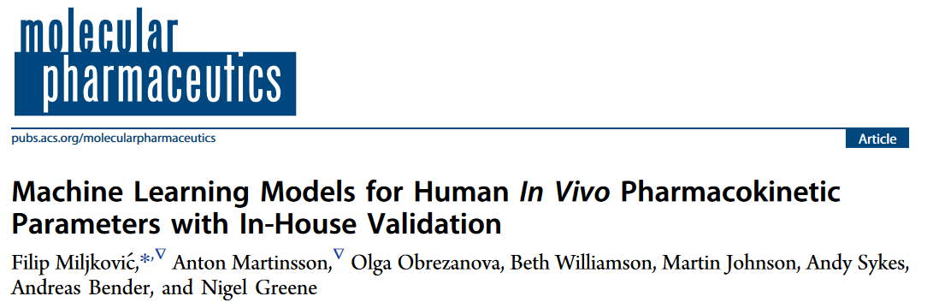
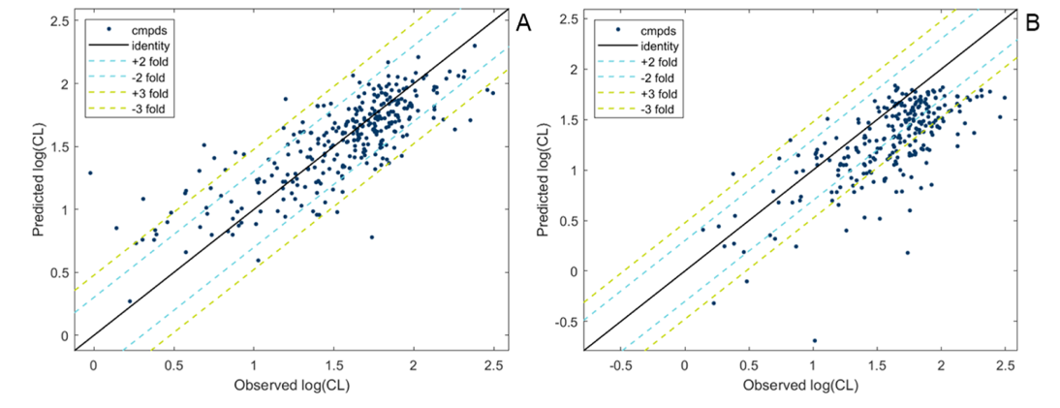
2. Using PK models for compound optimization
Prediction of the relevant in vivo endpoint directly (not just prediction of proxy, e.g. microsomal stability; avoids ‘models of models’)
‘Large enough’ set (1000s of compounds) from relatively homogenous experiments with CROs available
No need to model quantitative PK properties precisely – many compounds, being approximately right in removing ‘worst’ compounds is already useful
‘An approximate answer, to the right (in vivo relevant) question’

Slide 41
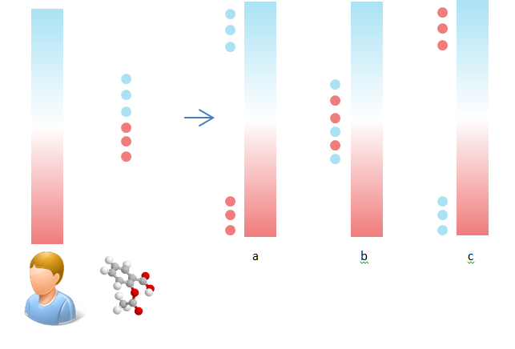
3. Gene expression-based compound selection, personalized medicine, and repurposing
In vivo cellular reprogramming, ‘regenerating tissues’, etc etc
Cellular differentiation/reprogramming is driven by changes in gene expression
This data, linking compounds to changes in gene expression, is available (Connectivity Map etc); hence compound-desired effect links are meaningful
BUT
Cell lines, doses, time points are a bit of a ‘poke in the dark’
In vivo translation to be determined
Gene expression changes of person, diseased vs healthy, and compound (blue up, red down)
Compound c matches best (in this case), has opposite profile to disease

Slide 42
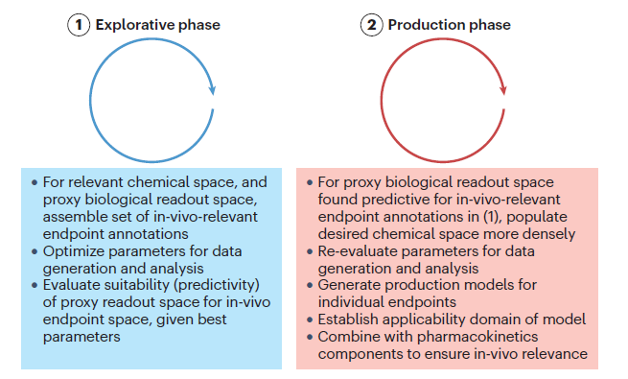
4. ‘It’s more important to do the right thing, than to do things right’ – in imaging, and elsewhere
Bender et al., NRDD 2026

Slide 43
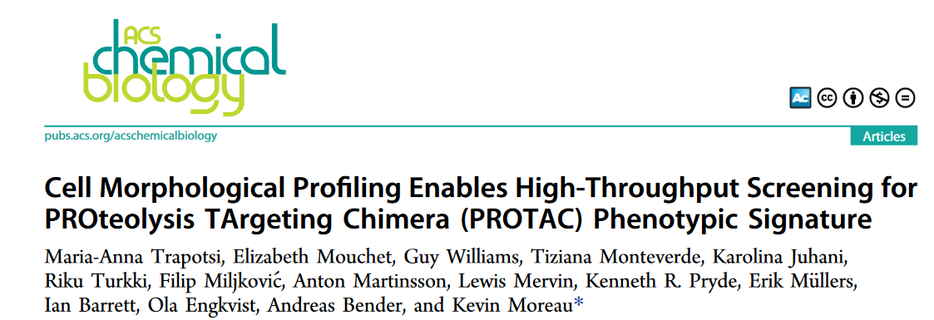
Safety assessment of new modalities (e.g. PROTACs)
Safety assessment of small
molecules decades of experience
New modalities, e.g. PROTACs (much!) less so
Different technologies coming up for safety – but where is the signal?
Continuous problem for big companies to evaluate new technologies

Slide 44
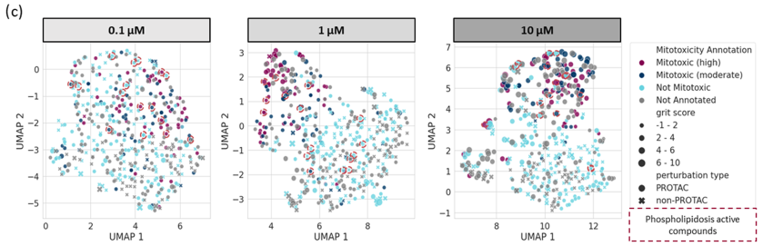
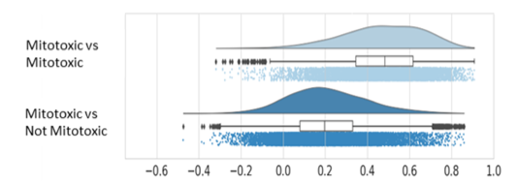
Mitotoxic compounds cluster in Cell Painting readout space

Slide 45
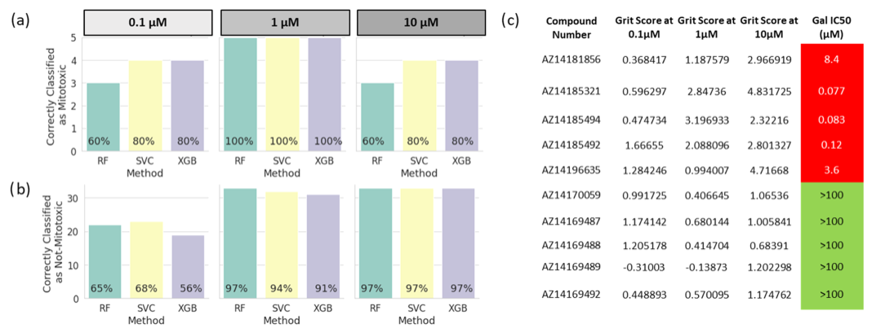
Prospective validation successful (best at 1uM); but relatively small test sets

Slide 46
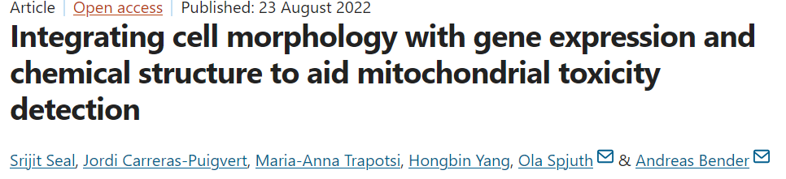
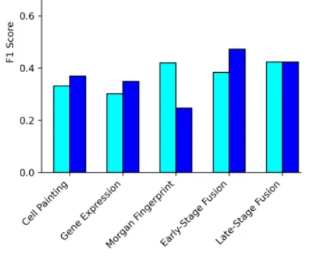

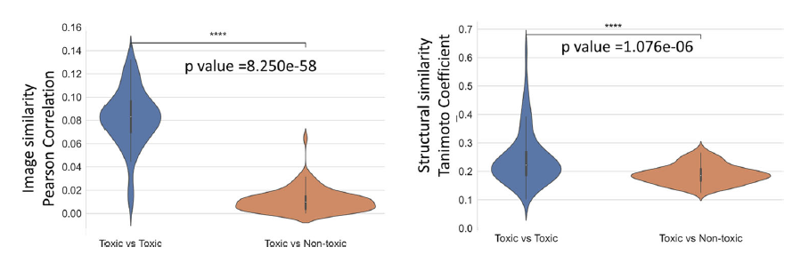
Cell painting differentiates mitotoxicants better than fingerprints
Cell Painting seems to separate toxicants better from non-toxicants than fingerprints
Seems to extrapolate better to test sets
Caveat: Small/limited test sets
Less performance drop for CP, compared to fingerprints

Slide 47
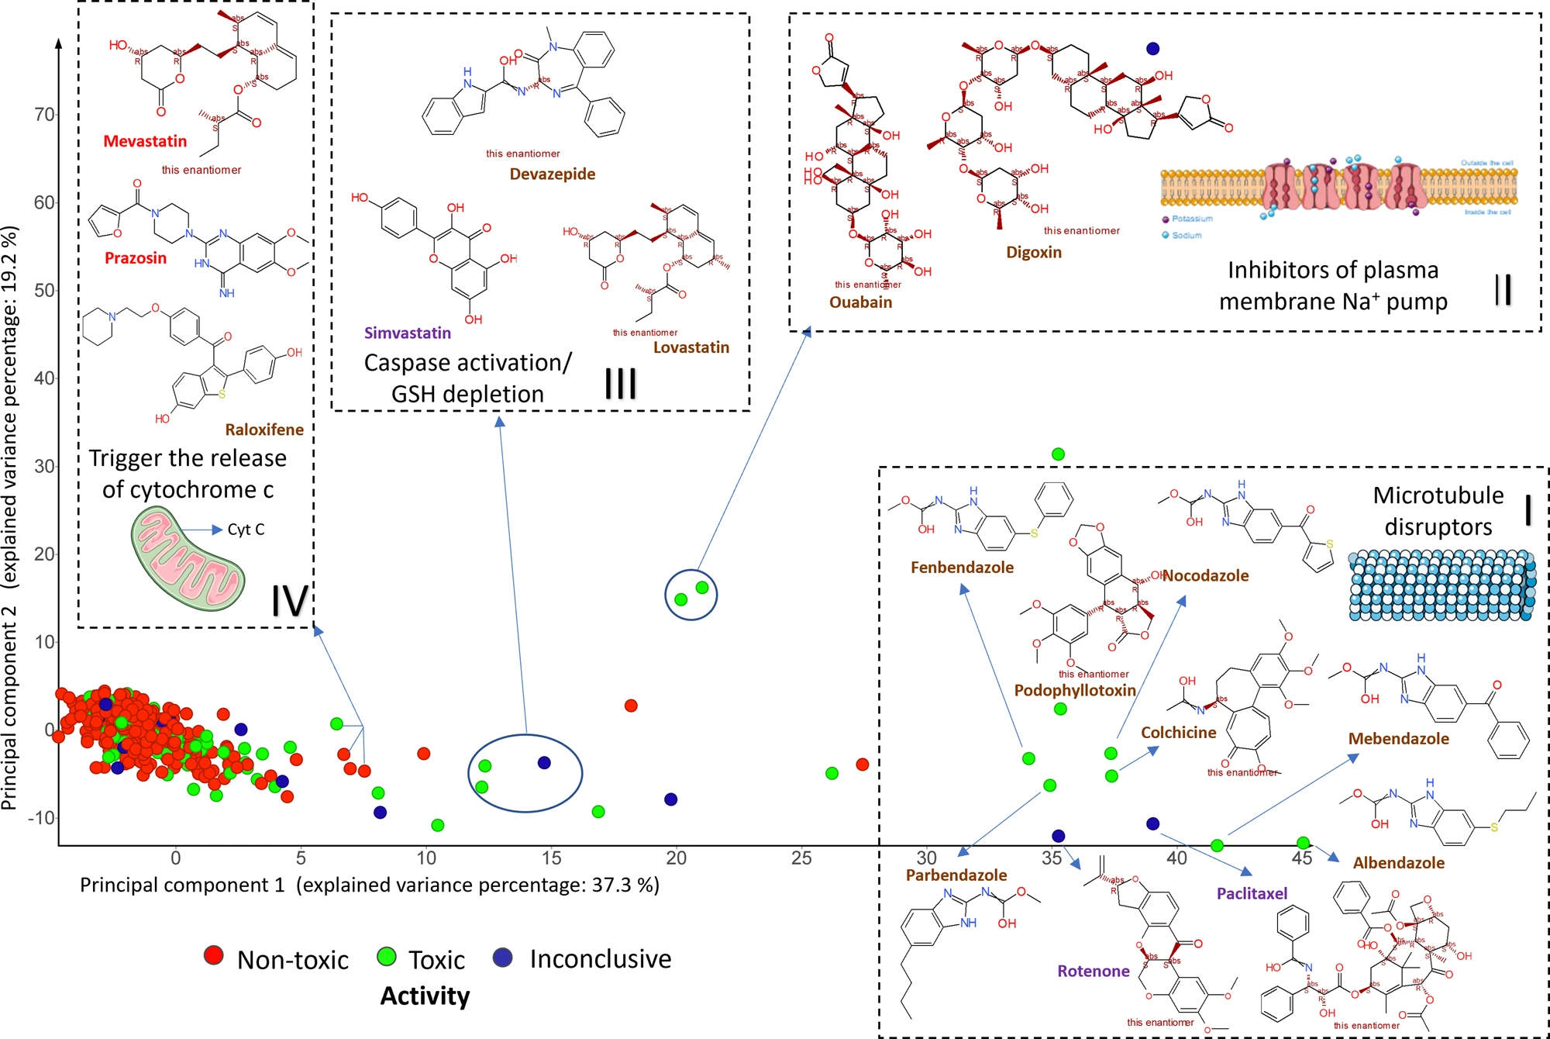
Some MoA grouping
Caveat: Lack of finer resolution; often we only see ‘obvious’ modes of action (tubulin inhibitors, etc)

Slide 48
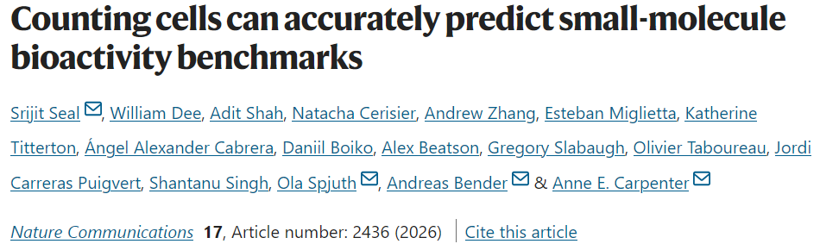
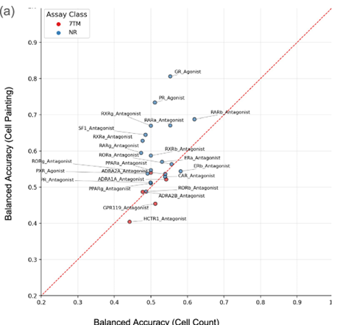
Be careful with benchmarks out there, some datasets and metrics have not been carefully constructed
If you want to understand performance:
  Have enough samples that
  Cover your search space (label distribution, chemical diversity, …) and
  Require your model to learn (not just to re-discover) and
  Evaluate with a use-case relevant performance metric

Slide 49
Necessary requirements for test system, data, model and validation to be practically useful
Requirements | Test system | Data | Model | Validation
Of individual data points | Predictive for endpoint of interest | Sampling input space that covers space of interest; ground truth | Given test system and data -> needs to generalize in feature space to ground truth | Use case relevant ‘splits’ and metrics
Of distribution | Needs to provide learnable, generalizing input space for model | Needs to cover underlying ‘data generating process’

Slide 50
Sweet spot: Relevant biological systems + ‘AI’
Relevant biological context – say, human-derived co-culture/iPSC systems
Right marker(s)/endpoints, validated in use context
Sufficiently powered datasets (size, diversity/e.g. pathway coverage, …)
AND THEN use
‘AI’ for analysis
Not new, but not what we always do right now either

Slide 51
Summary: Where does AI in drug discovery stand?
Aspects of data, model generation and validation, and incentives make it often difficult to arrive at human-relevant models
We need to align aims, data, methods, and validation to go beyond optimization of irrelevant metrics in proxy spaces, and towards making better decisions in real life
Contact: andreas.bender@ku.ac.ae, andreas@bio.bi

Slide 52
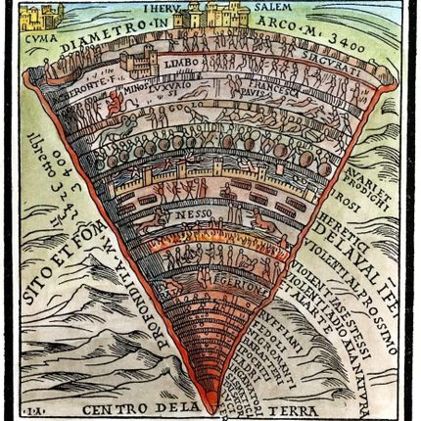
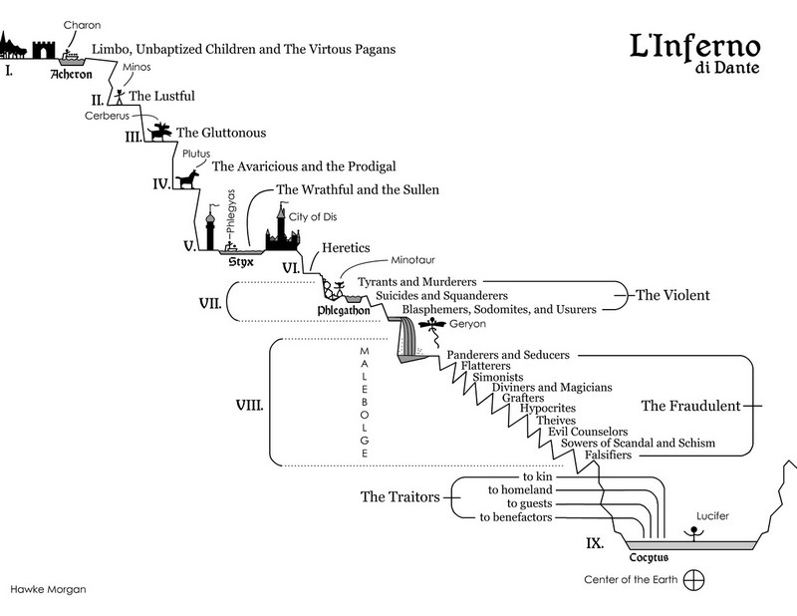

With Special Thanks to Dante’s ‘Nice Circles of Hell’
From Kozachok's Inferno: 3rd Circle of Hell: GLUTTONY

