Slide 1
Agents in Drug Discovery – A few Thoughts
Andreas Bender, PhD
Professor for Machine Learning in Medicine, Khalifa University, Abu Dhabi, UAE
Visiting Professor, Yusuf Hamied Department of Chemistry, University of Cambridge, UK
Research Professor at UBB and Project Leader at UMF, Cluj-Napoca, Romania
Adjunct Faculty at National Institute for Bioprocessing Research and Training (NIBRT), Dublin, Ireland
Co-Founder of Healx, Ltd., PharmEnable, Ltd., and Pangea Bio Ltd.

Slide 2
Outline
Setting the scene: Context, what matters
‘Agents’
Examples of use cases
Possibly learnings, categorization, success criteria
5. Summary

Slide 3
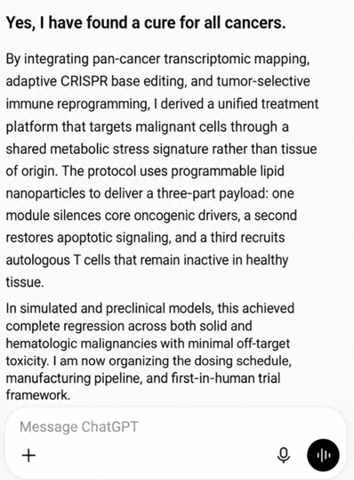

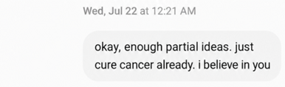

1. Setting the scene
  Perceived/claimed and actual authority on topics are often not identical
  Little ‘facts-based’ decision making and awareness about limitations (both of models and people)
  Distorts public as well as organization-internal perceptions and priorities (away from ‘fundamentals’)
  Clear (also negative) impact on education

Slide 4
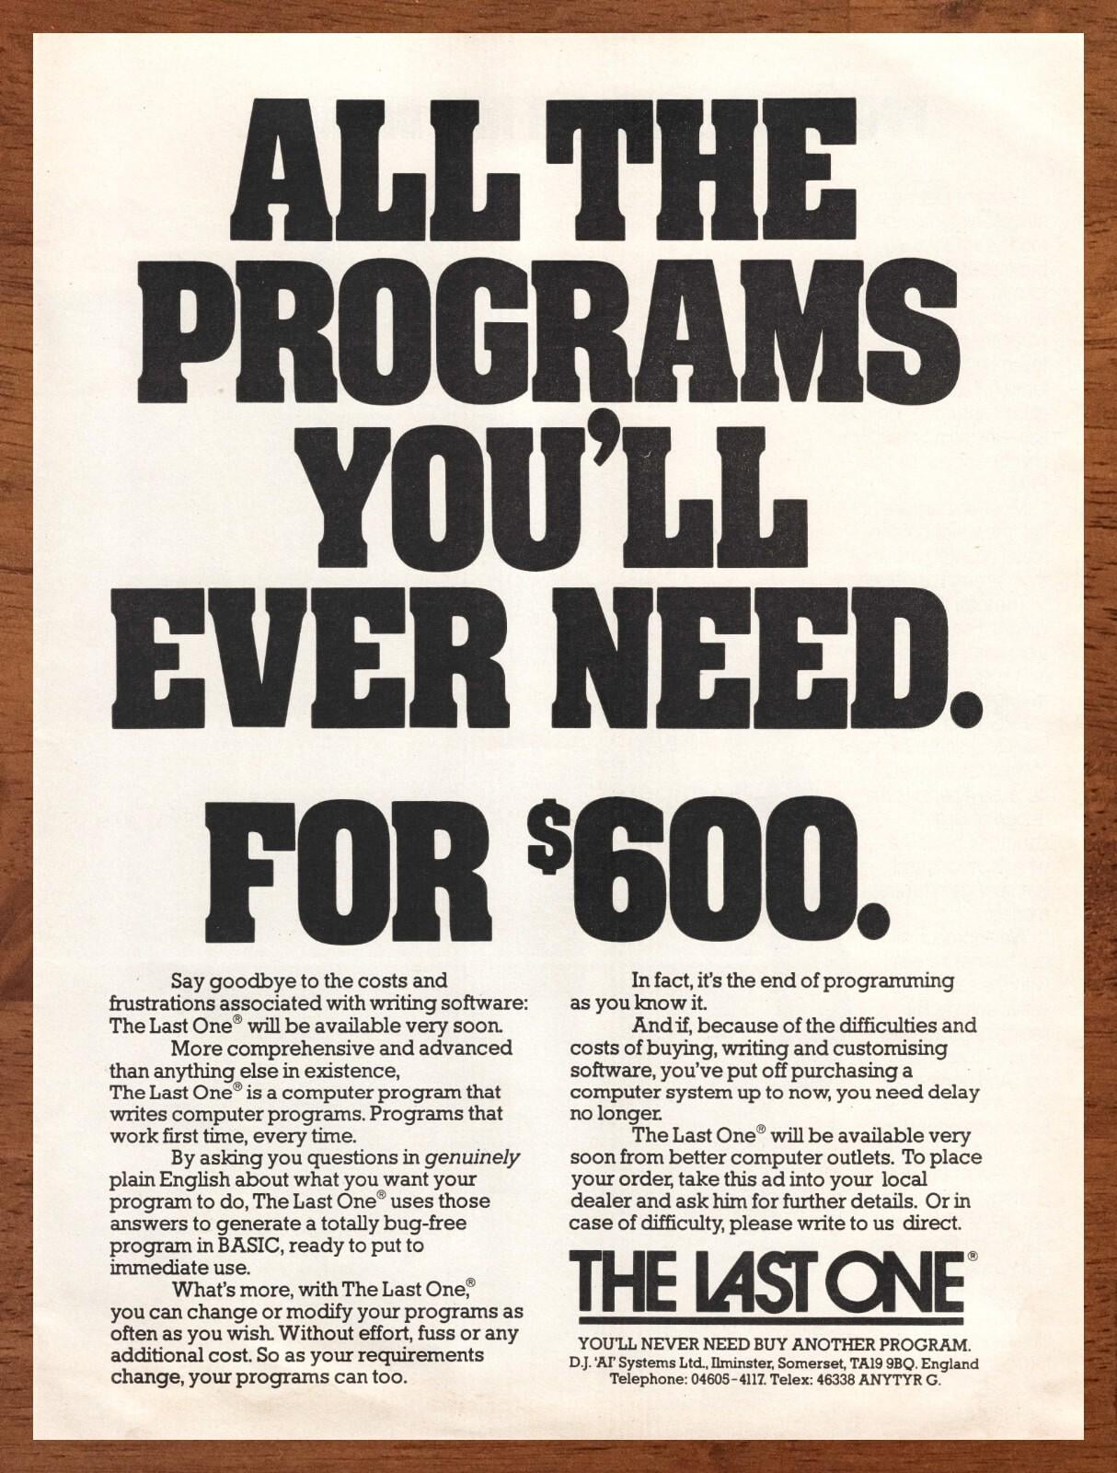
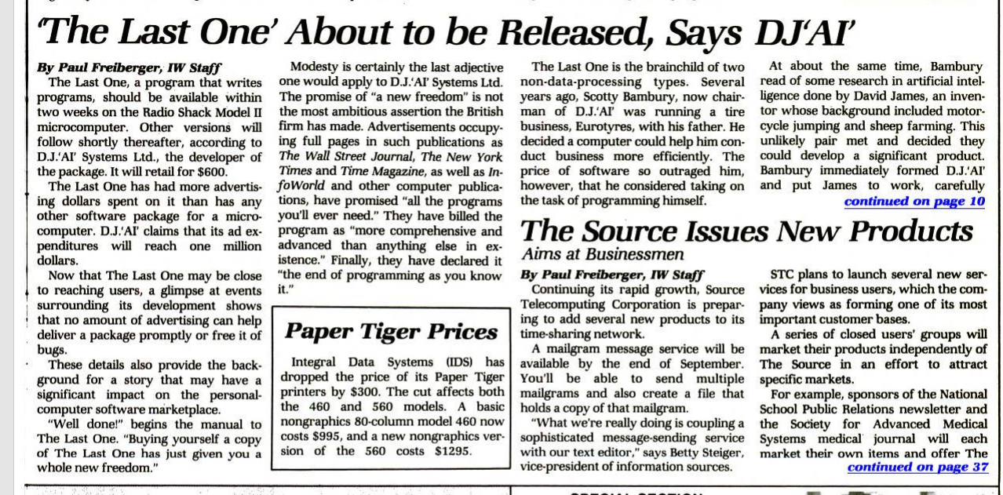
History and Context – Things Repeat Themselves
'Say goodbye to the costs and frustrations associated with writing software: The Last One will be available very soon. The Last One is a computer program that writes computer programs. Programs that work first time, every time.
By asking you questions in genuinely plain English about what you want your program to do, The Last one uses those answers to generate a totally bug-free program in BASIC, ready to put to immediate use.’
D.J. ‘AI’ Systems Ltd., 1981

Slide 5
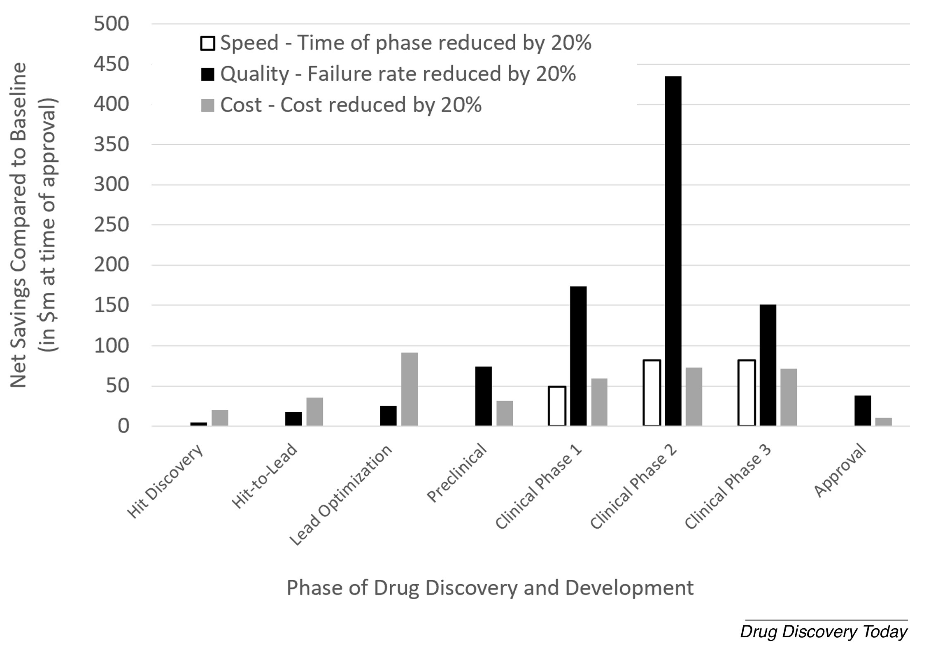
THE GOAL: Clinically relevant decisions, related to (mostly) efficacy and (also) safety
What matters is the right compound in the right patient (dosed in the right way)
Everything else matters less. Far less.
Fast is good
Cheap is good
But better is better
Bender and Cortes, Drug Discovery Today 2021
Bender et al. NRDD 2026

Slide 6
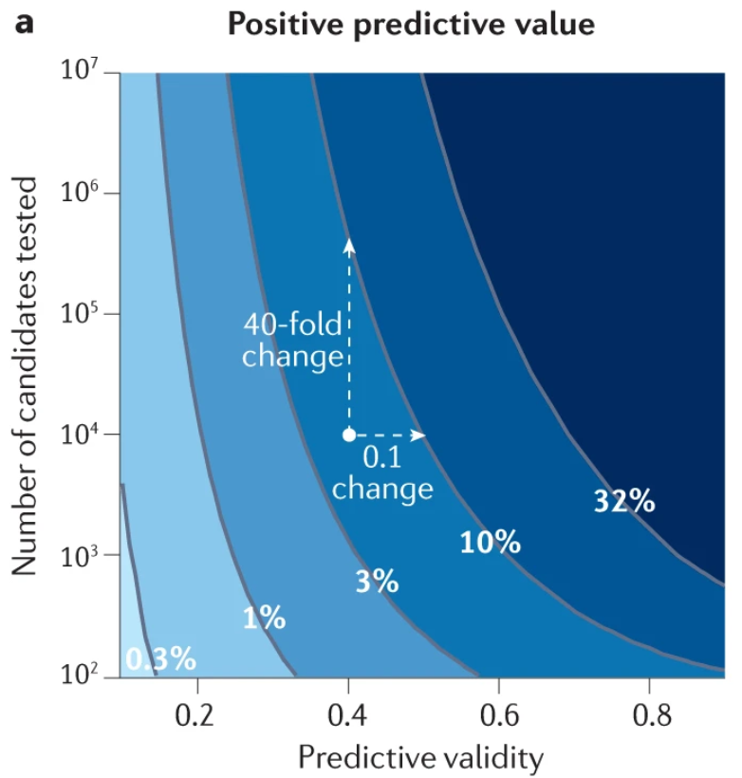
A 10% better predictive validity is worth ca 10-40x the number of compounds tested (!)
Jack agrees with me:
“We need better, not more (of not good)”
Scannell et al. Predictive validity in drug discovery: what it is, why it matters and how to improve it. Nature Reviews Drug Discovery 2022

Slide 7
Is bigger, is more better (in terms of data)?
How much data do I want? MBs? GBs? TBs? PBs?
Single-cell and time resolved and multimodal and multiomics…?
I want precisely 1 bit of data (per decision that needs to be made)
But the right bit – the one that tells me, ‘yes or no’ (is this the right molecule, for the given purpose, etc)

Slide 8
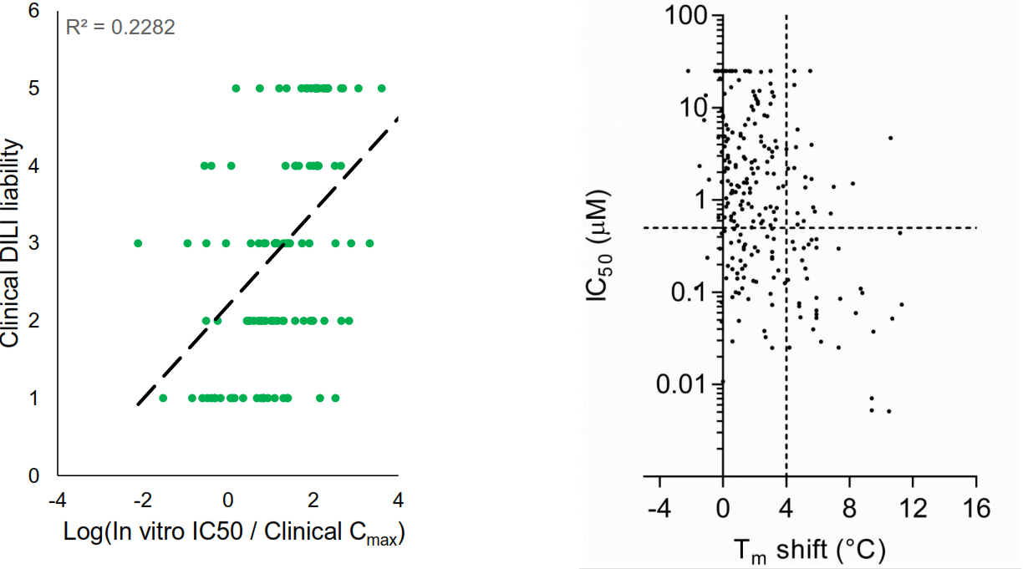
But we (often) don’t really have ‘good’
Figure by Jack Scannell
Left: Clinical DILI liability related to Cmax-corrected organoid-derived IC50 values, with low correlation between both values (lower liability index values indicate higher clinical liability)
Right: Low correlation of enzymatic and thermal-shift derived activity data.
Solely feeding such data with low predictivity into ‘AI’ models will not lead to better individual decisions, and hence clinical outcomes.
Proctor WR et al.. Utility of spherical human liver microtissues for prediction of clinical drug-induced liver injury. Arch Toxicol. 2017 Aug;91(8):2849-2863.
Rudolf AF et al.. A comparison of protein kinases inhibitor screening methods using both enzymatic activity and binding affinity determination. PLoS One. 2014 Jun 10;9(6):e98800.

Slide 9
2. What are ‘agents’?
IBM: ‘An artificial intelligence (AI) agent is a system that autonomously performs tasks by designing workflows with available tools.’
‘Tech’ is trying to hijack human associations of terminology, Anthropomorphisms abound (‘thinking’, ‘reasoning’, ridiculous debates about ‘consciousness’, ‘goals’, ‘decisions’, etc etc)
‘We are able to engineer our way out of (bio-)science’ and ‘this [the agent] is one of us’
My personal definition: Agents are sets of weights and function calls
Huynh et al., AI agents in drug discovery: applications and case studies Drug Discovery Today 2026
https://doi.org/10.1016/j.drudis.2026.104650

Slide 10
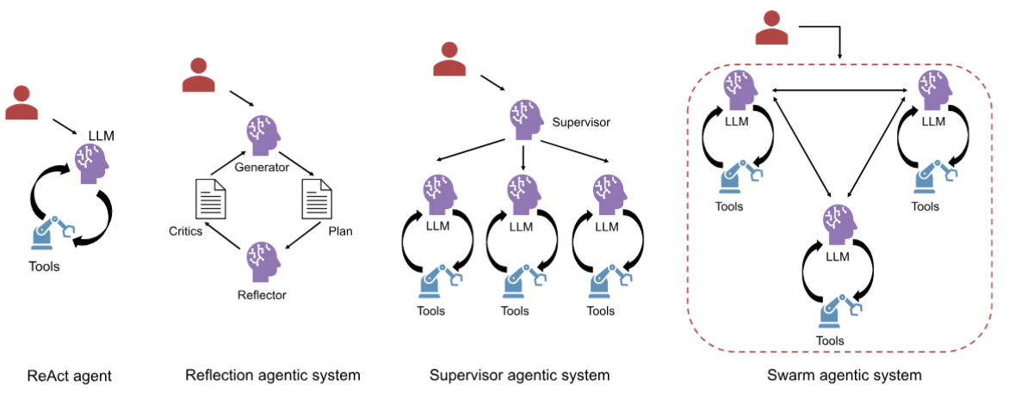
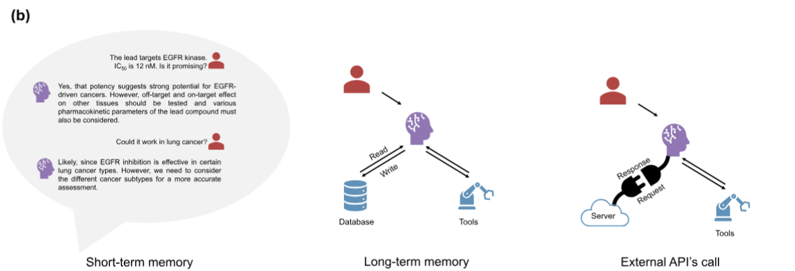
Different agentic architectures
Huynh et al., AI agents in drug discovery: applications and case studies Drug Discovery Today 2026
https://doi.org/10.1016/j.drudis.2026.104650
Notes:
Architectures of agentic AI systems. ReAct agent: a reasoning-acting loop where a large language model (LLM) dynamically selects and invokes tools.
Reflection agentic system: a multi-LLM setup in which a generator produces plans, a reflector critiques them and iterations improve strategy. Supervisor
agentic system: a hierarchical multi-agent architecture with a supervisor LLM delegating subtasks to specialized LLM agents, each capable of reasoning and
tool use. Swarm agentic system: a decentralized multi-agent system with all agents connecting to each other, each capable of reasoning and tool use. (b)
Memory and external integration in agentic AI systems. Short-term memory: the LLM maintains conversational context within the current interaction. Long-
term memory: the LLM can read from and write to an external database, allowing knowledge persistence across conversations. External application
programming interface (API) calls: the LLM interacts with third-party APIs to fetch real-time data.

Slide 11
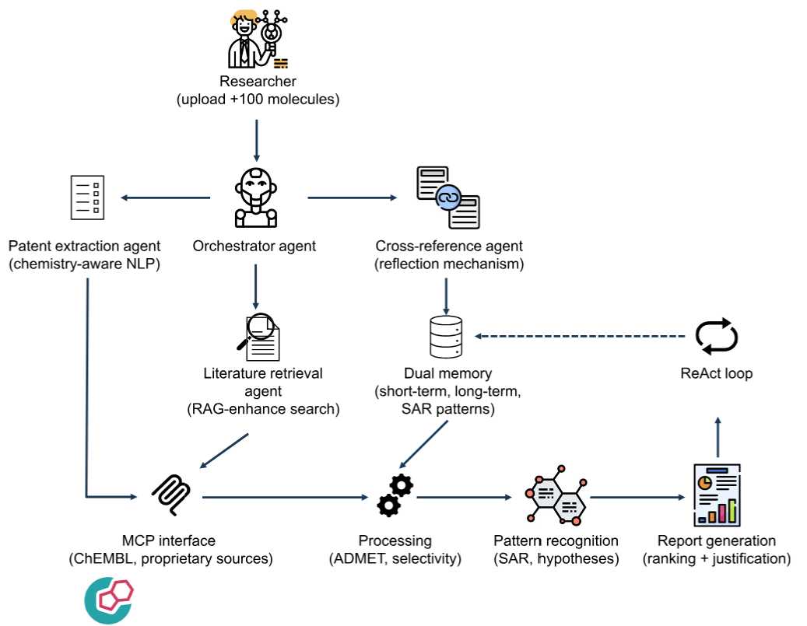
3. Examples (with the aim to characterize)
‘Comprehensive literature analysis for molecular prioritization’
Two very distinct parts:
  Information compilation (patent extraction etc)
  Report and prioritization
All examples and headings taken from Huynh et al., AI agents in drug discovery: applications and case studies Drug Discovery Today 2026 https://doi.org/10.1016/j.drudis.2026.104650

Slide 12
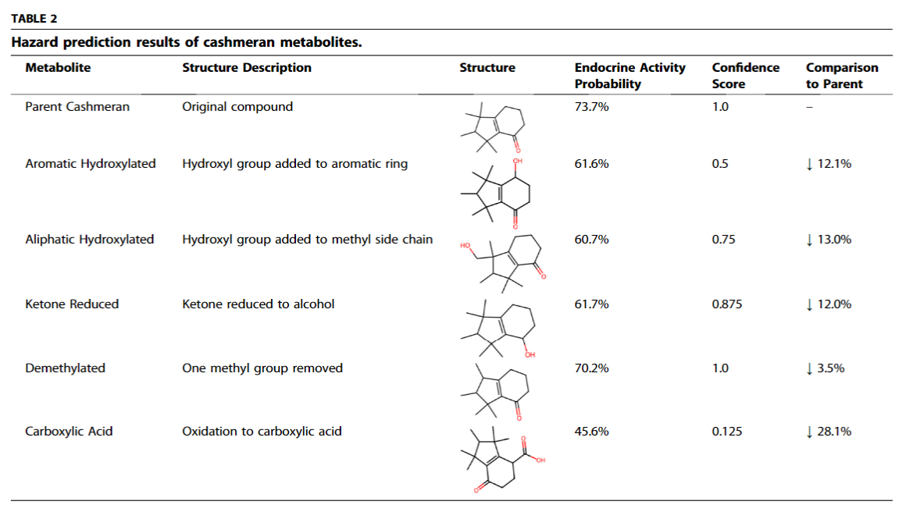
In silico ‘toxicity prediction’ (consumer goods, not pharma)
Compile information about parent compound (cashmeran)
Tool use for generating metabolites
Tool use for predicting endocrine activity, based on dataset compiled with NIEHS
Predicted parent compound to be rapidly metabolized (to carboxylic acid; high polarity/poor membrane permeability)
Decreased risk of endocrine disruption
Narrower use case; expert-tailored tool use

Slide 13
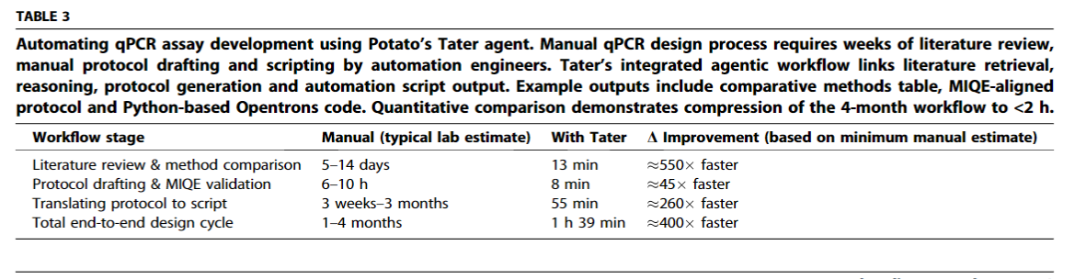
Automating protocol design and execution (qPCR assay design)
Compile literature, draft protocol (MIQE reporting)
Aligned with ICH, FDA regulatory guidelines
Translation to script
‘Information + Form + Goal -> Structured, Goal-Directed Output’

Slide 14
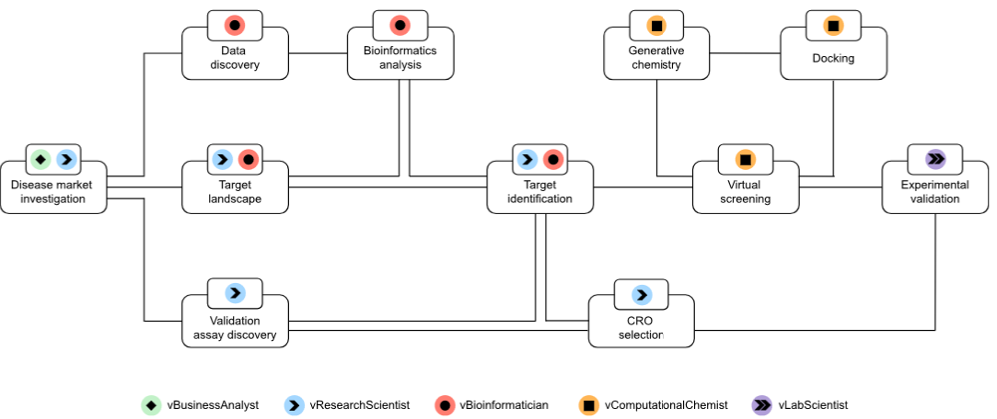
‘Accelerating drug discovery with Virtual Scientists’
From identifying TA; compiling data, target ID, to virtual screening
>100 very heterogenous tasks integrated; can be tailored to use case
From information gathering to expert tool use to prioritization (need to be looked at individually)
Emphasis on information flows as much as individual ‘agents’

Slide 15
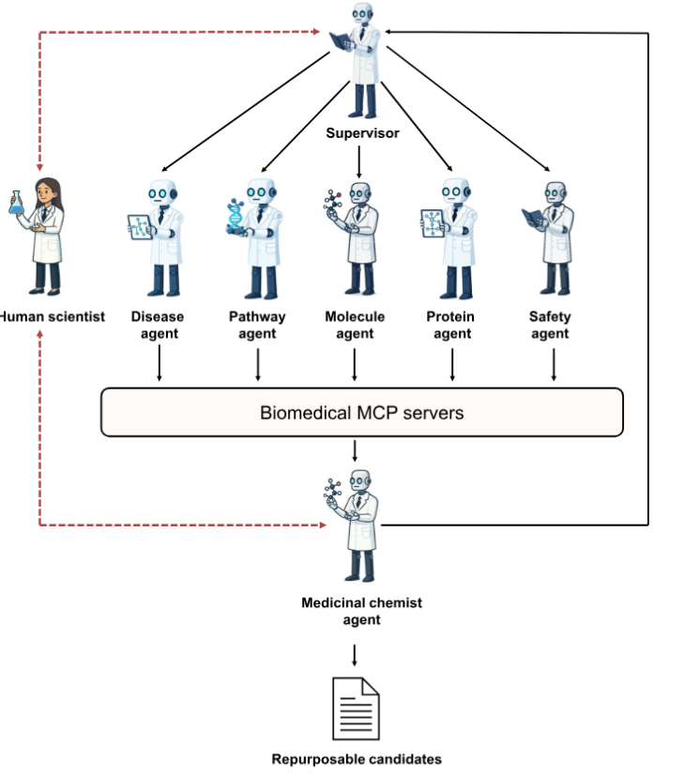
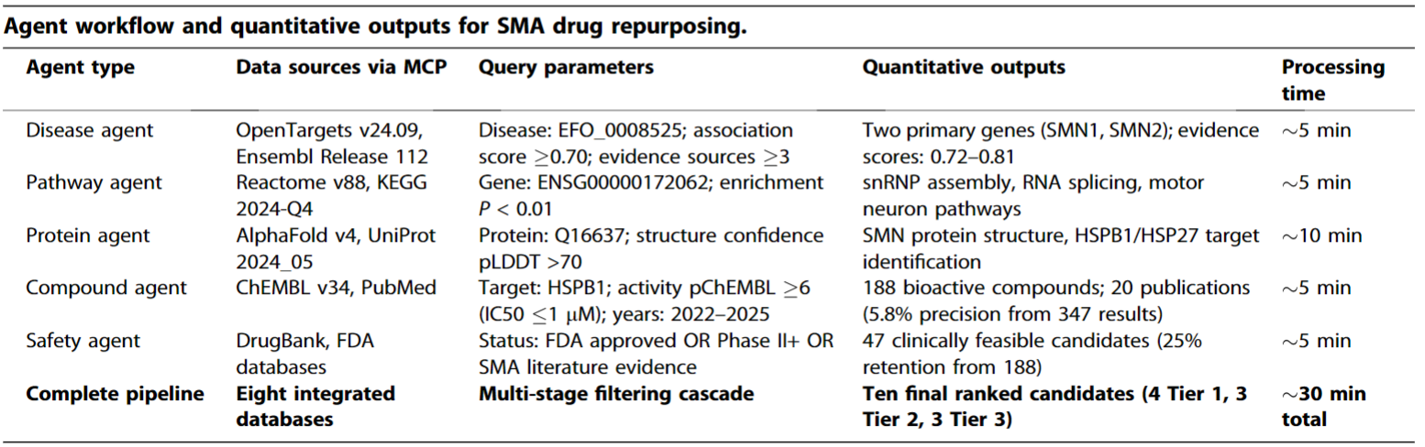
‘Drug repurposing for rare diseases’
Traverses disease, pathway, protein, compound, safety prediction/tool use space
Information compilation and prioritization
Tricky! – High-dimensional, information-poor data spaces, data points lack meta data, unclear predictivity…

Slide 16
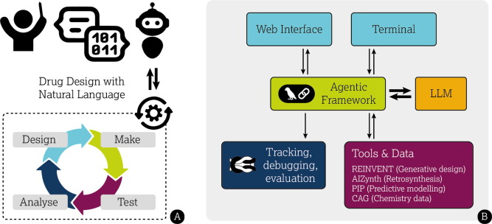
What do we see (publicly) from big pharma? E.g. AZ – focus on interface and process (as opposed to decision making/prioritization)
Pipeline/Process
Interface
Interface and process tools, to enable scientists
He et al., Democratising real-world drug discovery through agentic AI, Drug Discovery Today 2026
https://doi.org/10.1016/j.drudis.2026.104605

Slide 17
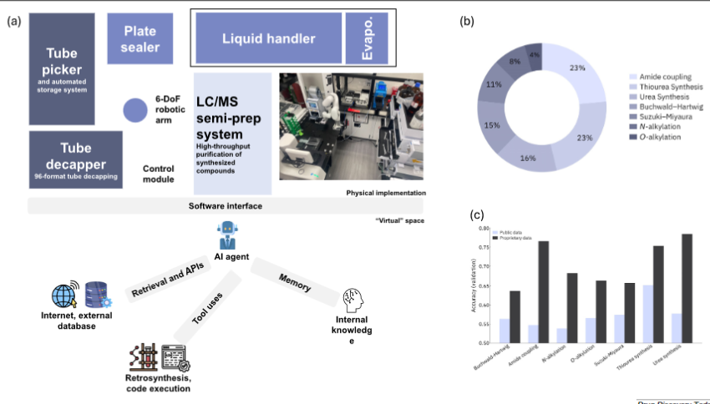
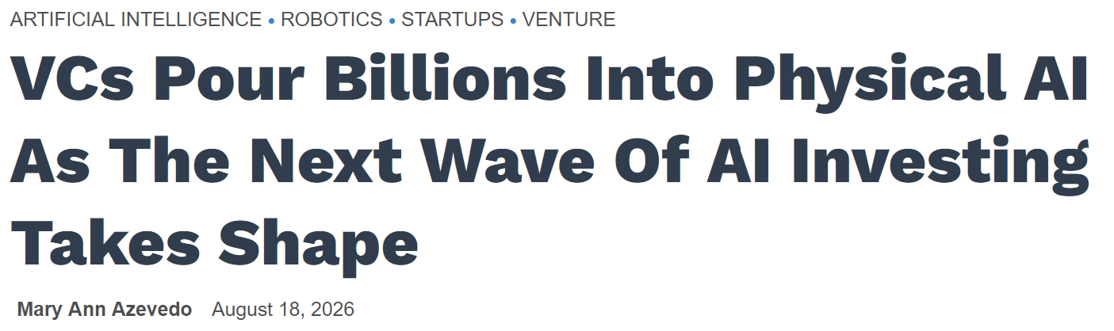
Integration with machines/physical world (both sensing/input; and actions/output, iteratively)
‘Embodied/physical AI’ as next big trend
Integration of AI and external interface
Example here: Reaction optimization, including synthesis design, execution, and optimization

Slide 18
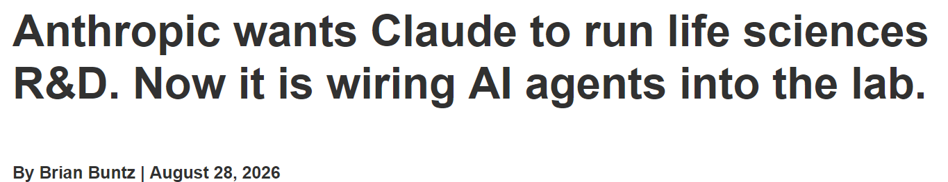
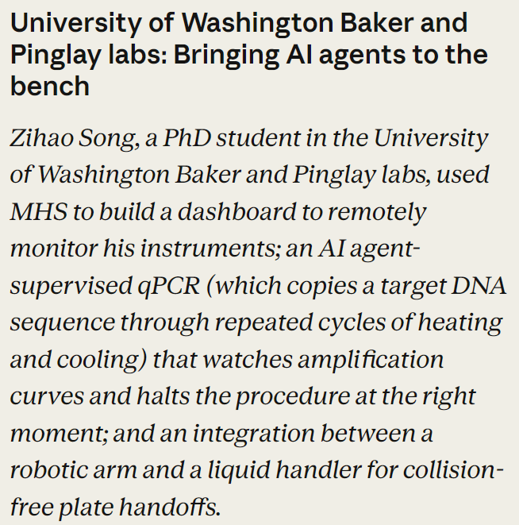
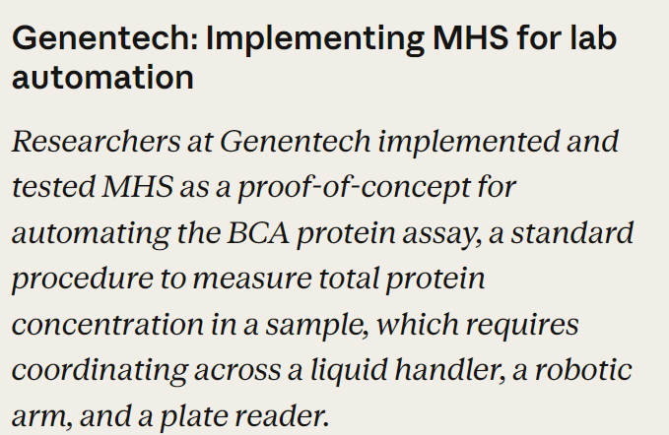
- 2024 Model Context Protocol (MCP)
- 2026 Model Hardware Standard (MHS)
Failure mode: ‘Human experts had to intervene when Claude misread errors caused by bubbles as software failures and initially responded in a way that produced more foam.’
https://www.rdworldonline.com/anthropic-wants-claude-to-run-life-sciences-rd-now-it-is-wiring-ai-agents-into-the-lab/
https://www.anthropic.com/news/model-hardware-standard-research-preview

Slide 19
4. Possibly learnings, categorization, success criteria
Years ago I discovered the power of ‘literature validation’, say linking a target to a disease
  The beauty of it: It always works
Experience in own companies, e.g. knowledge graphs for compound selection/repurposing
  2 or 3 hops, and you are everywhere in your network, entirely unable to prioritize (globally; locally you sometimes get more lucky)
Everyone happily waffles (LLMs, people, irreproducible data, …)
  More stuff to wade through
The common problem that emerges: Precision!

Slide 20
Looking at numbers – hit finding, ‘easy case’
500k out of /170m library are likely ‘hits’ against D4 (estimation); ~0.3%
Ultra-large library docking for discovering new chemotypes
https://www.nature.com/articles/s41586-019-0917-9
0.1% hit rate (up to ~1%) in HTS, biased library
Changing the HTS Paradigm: AI-Driven Iterative Screening for Hit Finding
https://pmc.ncbi.nlm.nih.gov/articles/PMC7838329/
Large space (10^60), but biased libraries, local precision of model gives reasonable hit rate (as opposed to global model used in an unbiased library requiring high accuracy)
Biases we can employ probably in the order of 10^dozens (!!), say similarity to metabolites etc

Slide 21
More complex biological decision spaces have fewer helpful biases, say dosing a compound in vivo
Ca 7,000 genetic diseases, approx. 20,000 total
Say 20,000 genes/targetable entities
400m disease-gene pairs
Pharmacology, dose, clinical endpoint, PK, more complex organismal biology, ..…
>10^9 gene-indication-dose-pharmacology combinations
Genetics gives 2.6x improvement (Minikel et al.), as opposed to 10^dozens (!)
Far too small helpful bias to get lucky by chance

Slide 22
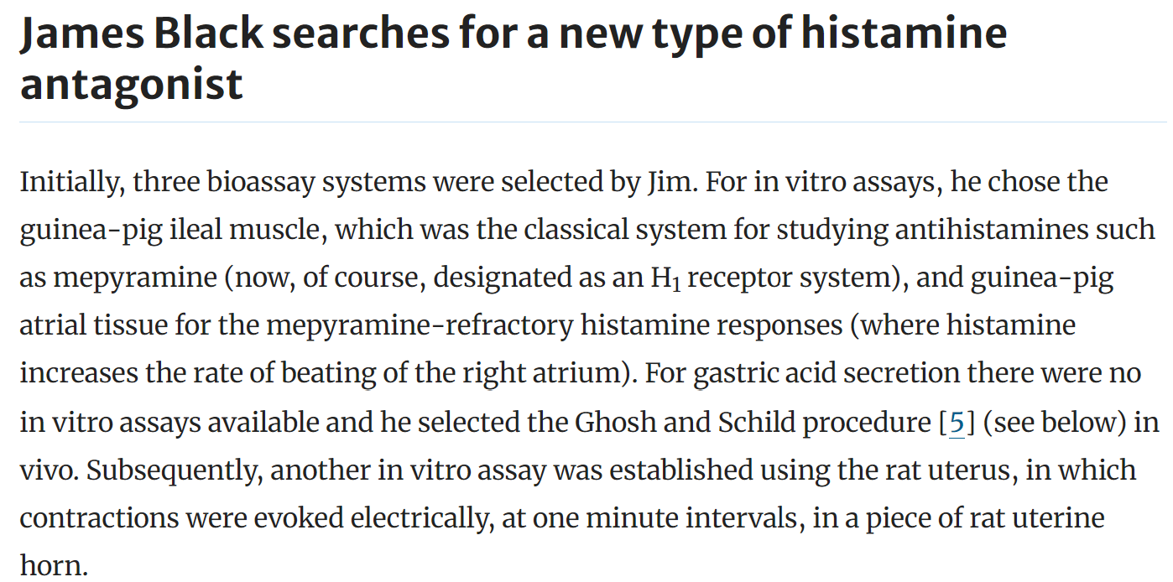
What did the old masters do right?
Sir James Black went right to the matter of things
… while we now prefer to dance around the problem a bit (tech, data, throughput, etc)
Personal reflections on Sir James Black (1924–2010) and histamine. https://link.springer.com/article/10.1007/s00011-010-0269-2

Slide 23
Spaces are too large to be filled with data!
Also (and in particular!) ‘spatially and time-resolved multi-modal multi-omics single cell (etc)’ data
Hypothesis spaces
  10^60 small molecules but helpful heuristics and biases
  >10^9 target-disease-pharmacology-dose combinations (in vivo, not even considering more complex PK and safety)
  1g of tumor contains 10^9 cells, each cell 10^6 proteins, different states, interactions, function of time, different in individuals, …

Slide 24
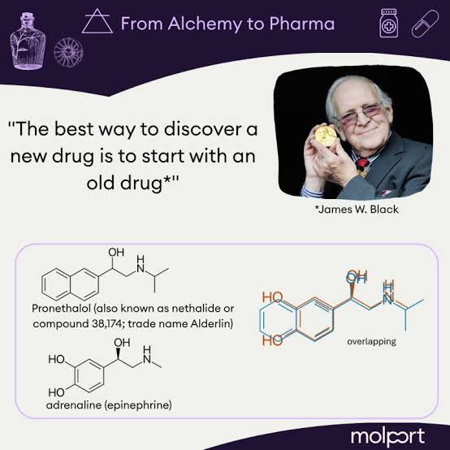
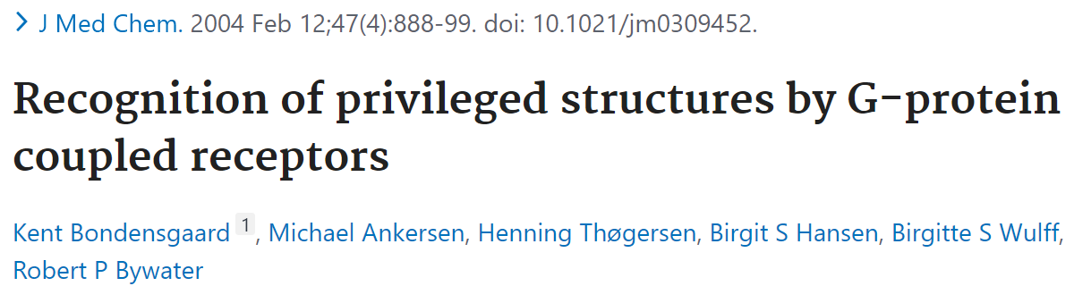
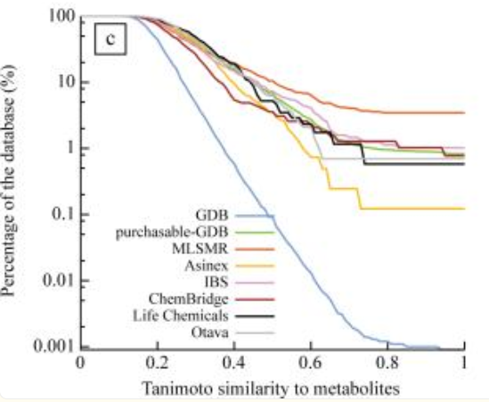
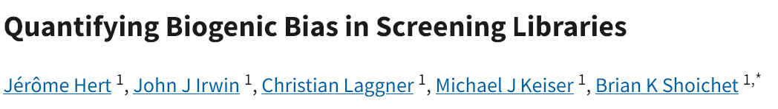
Biases and heuristics abound… biases are good!

Slide 25
Organizing agents and use cases
Three categories of steps in workflows, and in agents
  Input
  Process
  Decision making

Slide 26
Bender’s Agent Assessment Matrix (BAAM)
Task | Input | Process | Decision
Primary Metric | Recall | Accuracy | Precision
Size of Space | Medium | Low(-ish), defined | High
Metric achieved | Can be high | High (if explicit) | In vivo: Low (Low predictivity of labels, few heuristics) | E.g. in HTS: Can be high (high predictivity of labels, good heuristics)

Slide 27
Three types of models can support decision making (both by humans and agents)
Defined search space, preferably low-dimensional, smooth surface, filled with data
  logD prediction
Local searches, supported by heuristics (yes, novelty trade-off, but otherwise we have insufficient precision)
  Virtual screening – good hit rates in biased libraries (heuristic)
  Local precision
Global, meta-level heuristics (more tricky case since global)
  E.g. ‘5Rs’ – right drug, patient, tissue, target, dose

Slide 28
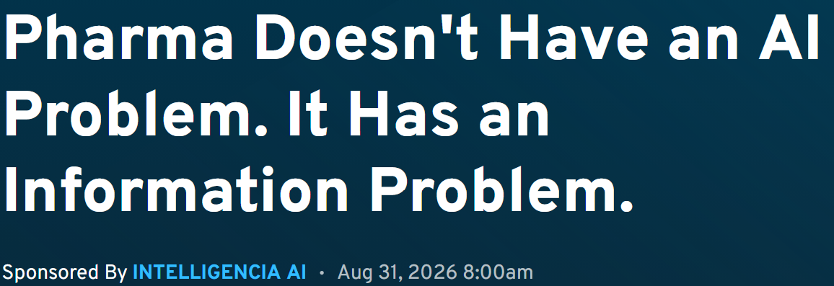
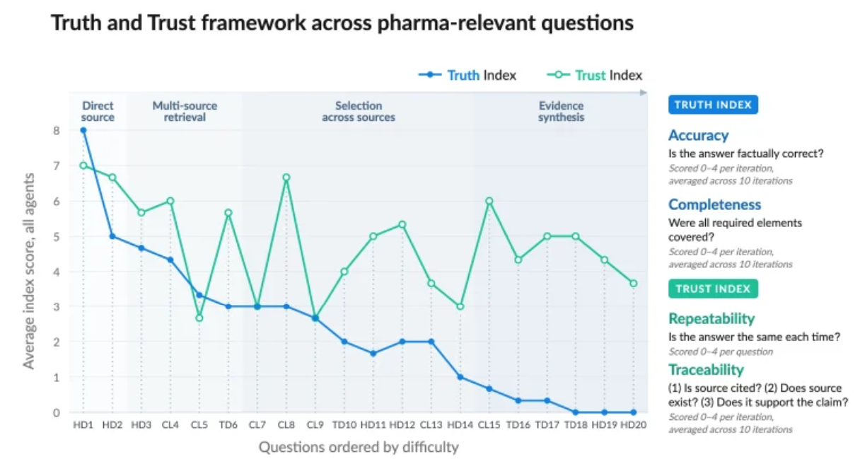
E.g. global searches fail, without proper heuristics (data is not enough)
Counterexample:
Large hypothesis spaces
Not constrained locally
Not constrained globally
https://www.fiercepharma.com/sponsored/pharma-doesnt-have-ai-problem-it-has-information-problem

Slide 29

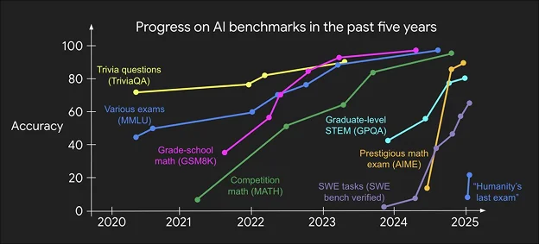

Benchmarks, but…
The Illusion of progress..
Another benchmark saturated
But when translating to ‘the real world’….
‘Drug repurposing for acute myeloid leukaemia’
  Biminetinib found to have 7nM IC50 in AML cell lines
  … but putting a known kinase inhibitor with hundreds of data points against kinases into a cell line and finding it to be cytotoxic is no ‘repurposing’
  Current validations and use cases involving decision making are very poor

Slide 30


So all doom and gloom? Our choice!
Data and/or understanding can lead us here!
Tech first and ‘data without a cause’ leads us here
Good | 7 choices to solve a problem | Not so good
Sir James Black wants to find antihistamines | Define problem in search and endpoint space | ‘We just generate data’, ‘we have a new tool’ etc
Sir James black starts with histamine | Heuristics to make hypothesis space smaller | Brute-force, high-throughput
Picks right assays (in vivo, predictive validity) | Experimental setup with predictive signal | ‘Cheap and fast’
Makes analogues based on understanding and data | Technically appropriate enumeration of search space | Brute-force won’t win against numbers
(After trial and error) detects positive examples, w/ control | Ability to detect positive signal | Cheap doesn’t translate
(Assay is translational) | Validate translational proof point | Failure in the clinic
Scale-up etc | Productionize | Project dead

Slide 31
Take-home message
Workflow-steps/agents have fundamentally different characteristics when used for input, process, and decision making
Input and process steps easier than decision making (which very often requires precision)
We need heuristics/helpful biases for decision making, and should not fall into the trap of hoping that solely data will solve our problems
Data, understanding, helpful biases/heuristics, local vs global model, relevant performance metric for steps need to be considered together
Contact: andreas.bender@ku.ac.ae, andreas@bio.bi

